Slide 1
Charles Dickens & Victorian England
Great Expectations

Slide 2
England of the 1860s
Salvation Army founded by William Booth in London to minister to the lower classes
Prime Ministers in the 1860s were primarily of the Liberal party (which advocated classical liberalism or laissez-faire).
Laissez-Faire: the economy works best if private industry is not regulated and markets are free

Slide 3
Romanticism
Emphasized emotion
High view of nature and those close to nature (for example, children and native Americans)

Slide 4
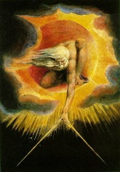
Ancient of Days William Blake 1794

Slide 5
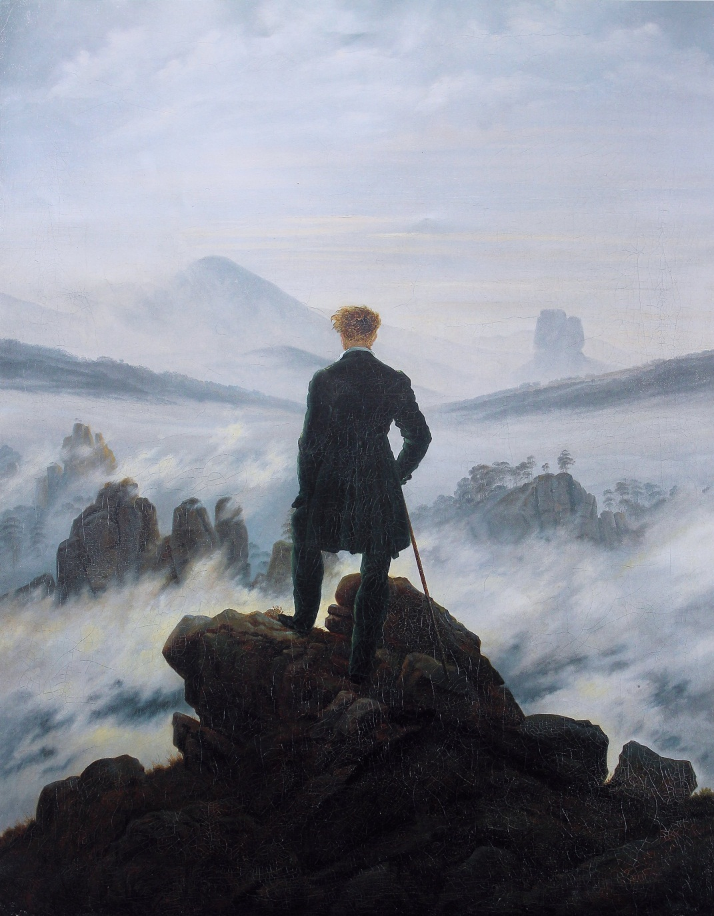
Wanderer Above the Mist
Caspar David Friedrich
1818

Slide 6
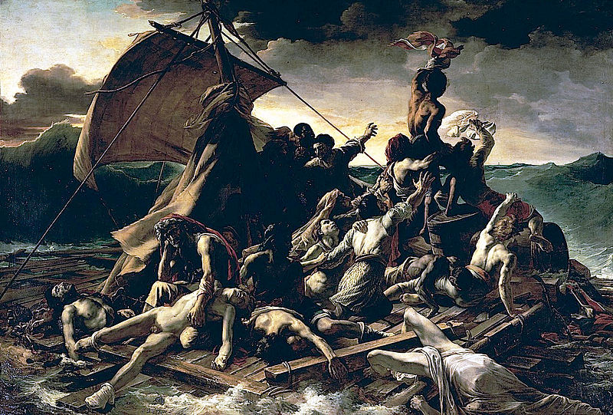
Raft of the Medusa Théodore Géricault 1819

Slide 7
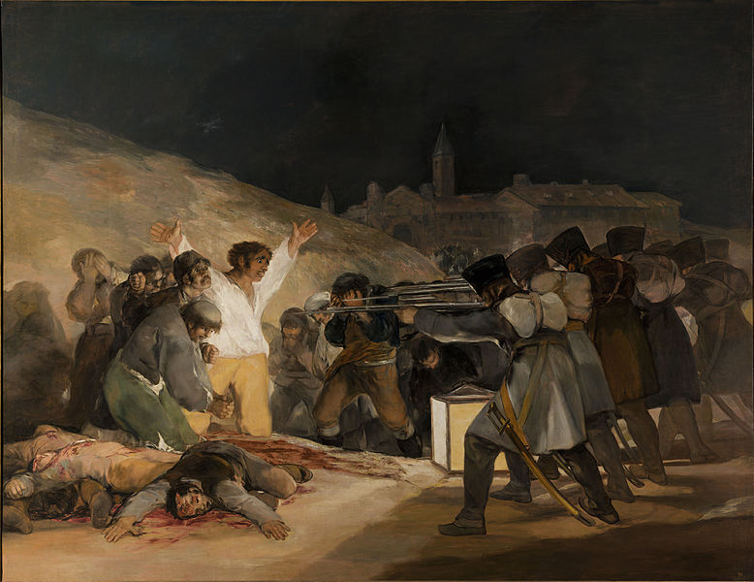
The Third of May 1808 Francisco Goya 1814

Slide 8
Realism
Realism emphasized an accurate portrayal of the subject
Landscapes, still lifes, and depictions of every day life were popular in painting
Replaced the emotion of Romaticism with more realistic subjects
Realism was prevalent in art and literature in the mid- to late nineteenth century

Slide 9
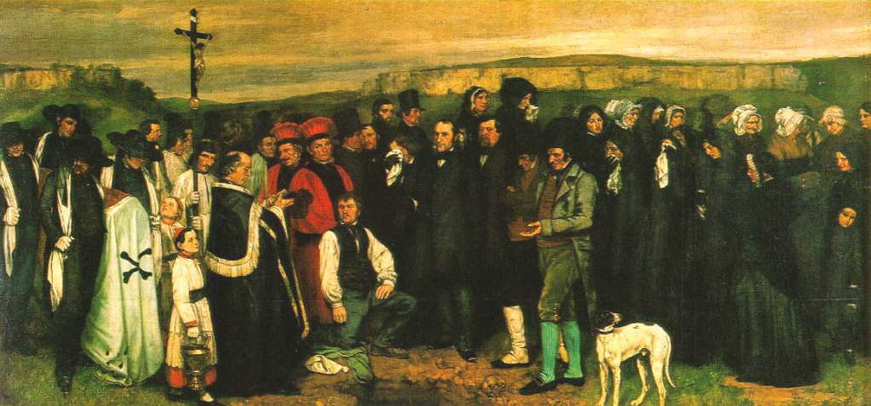
A Burial at Ornans
Painted by French artist Gustave Courbet in 1850
Depicts the funeral of Courbet’s great uncle

Slide 10
A Burial at Ornans

Slide 11
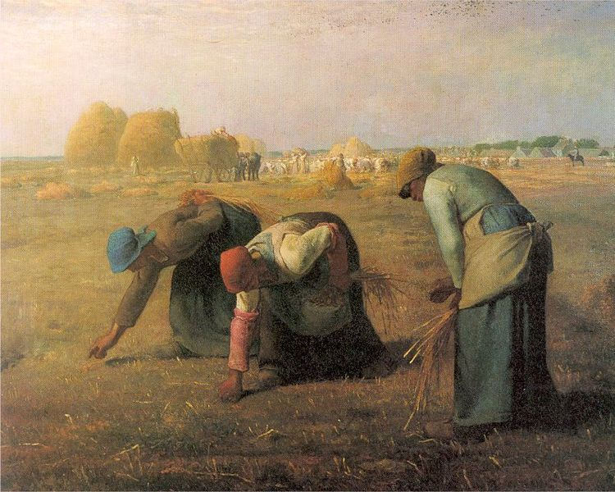
The Gleaners
Painted by French painter Jean-François Millet in 1857
Depicts peasant women gleaning after a harvest

Slide 12
The Gleaners

Slide 13
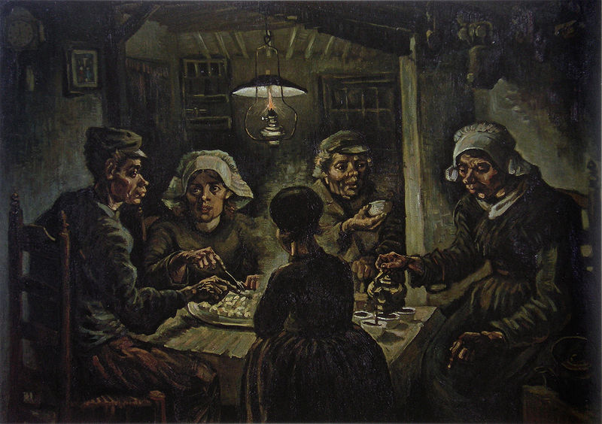
The Potato Eaters
First major work by Dutch artist Vincent van Gogh (1885)
Not realist in style, but content

Slide 14
The Potato Eaters

Slide 15
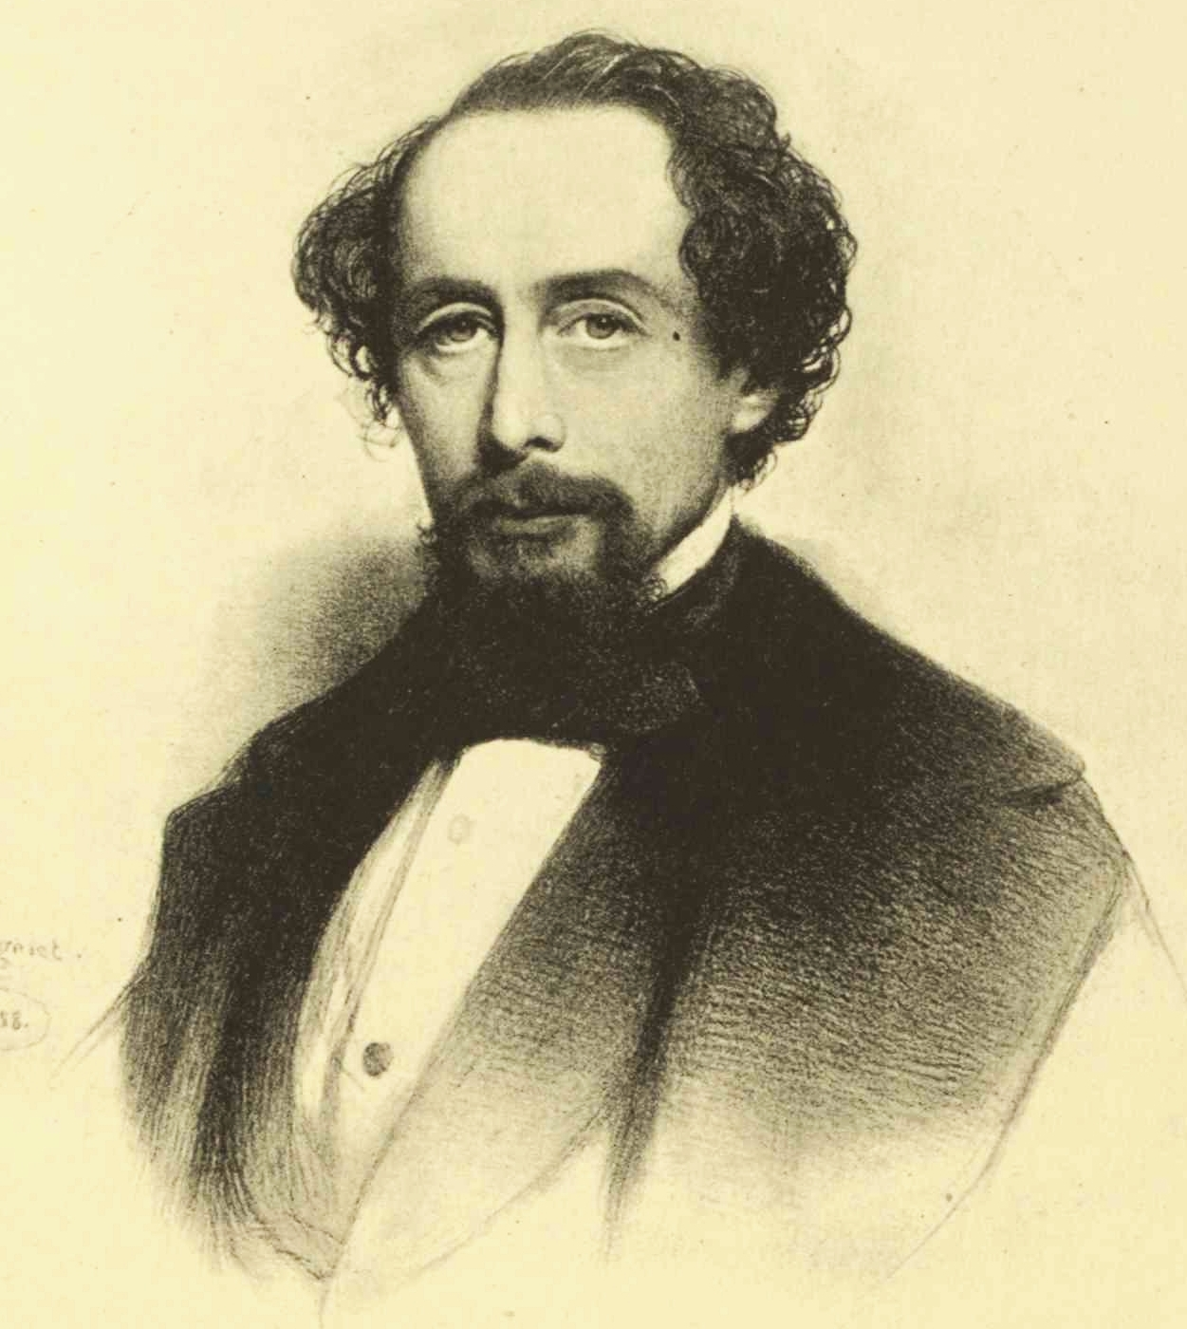
Charles Dickens
b. 1812 in Portsmouth
d. 1870. Buried in Westminster Abbey
Wrote novels, short stories, plays, and non-fiction
Very popular during his time
Created characters from his own experiences and observations while walking around London

Slide 16
Charles Dickens’ Childhood
Came from a poor family
Father sent to debtor's prison
Worked in a factory as a child
Didn’t see his family often
He expressed feelings of humiliation, loneliness, and rejection in the children of his novels

Slide 17
Serial Novels
Chapters of the novel were published in monthly magazines
Allowed authors to refine the novel based on popular taste
Chapters generally ended with a cliffhanger

Slide 18
Major Works
The Pickwick Papers (1836-7)
The Adventures of Oliver Twist (1837-9)
Nicholas Nickleby (1838-9)
A Christmas Carol (1843)
David Copperfield (1849-50)
Bleak House (1852-1853)
Hard Times (1854)
A Tale of Two Cities (1859)
Great Expectations (1860-1)

Slide 19
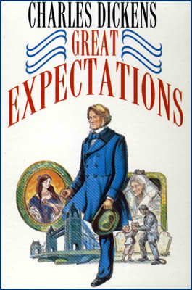
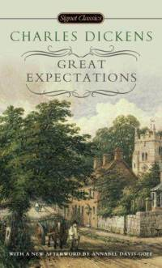
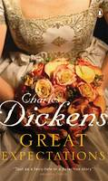
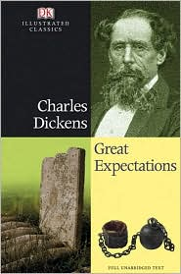
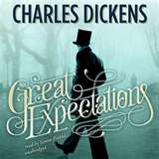

Slide 20
Great Expectations
Published in weekly serial All the Year Round from December 1860 to August 1861
Written in first person from the view of the orphan Pip
Takes place in the mid-nineteenth century in London and southeast England

Slide 21
Themes in Great Expectations
Social Class
Ambition & Self Improvement
Crime, Guilt, & Innocence
Loyalty & Affection
Great Expectations

Slide 22
Symbols in Great Expectations
Time: Satis House & Clocks
Guilt & Innocence: gallows, prisons, handcuffs, policemen, lawyers, courts, convicts, chains, and files
Uncertainty: marsh mists and fog

Slide 23
Characters in Great Expectations
Villains | Victims | Vindicators
Mrs. Joe | Pip | Joe Gargery
Compeyson | Magwitch | Mr. Wemmick
Miss Havisham | Herbert | Biddy
Dolge Orlick
Bentley Drummle

Slide 24
Characters in Great Expectations
Narrator: Pip
Point of View: First Person (Pip)
Protagonist: Pip
Antagonists: (change throughout the novel) Magwitch, Mrs. Joe, Miss Havisham, Estella, Orlick, Bentley Drummle, and Compeyson

Slide 25
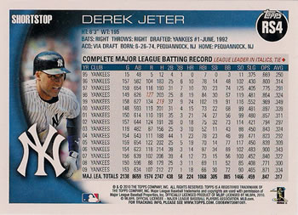
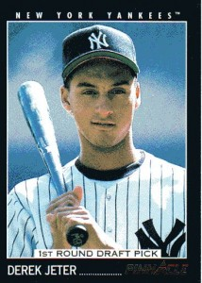
Character Cards
Back:
Relation to Pip
Main facts
Personality
Important Quotes
Add Information as you learn more about the character
Front:
Name
Sketch (based on description- try to visualize the character)

Slide 26
Create Character Cards
Important Characters:
Philip Pirrup (Pip)
Estella
Miss Havisham
Joe Gargery
Mrs. Joe Gargery
Biddy
Uncle Pumblechook
Herbert Pocket (the pale young gentleman)
Mr. Jaggers
Wemmick
Dolge Orlick
The Convict (Pip’s Convict)

