Slide 1
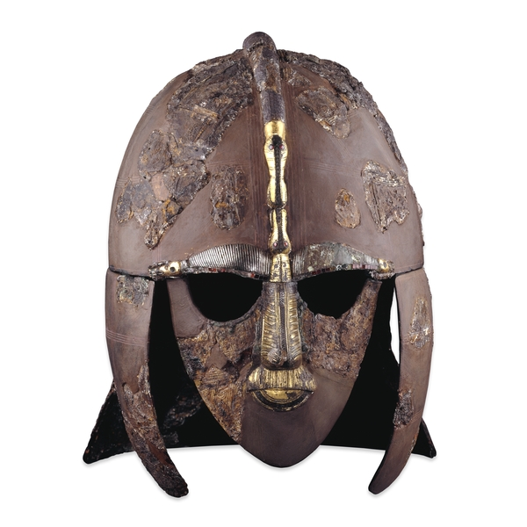
Beowulf
Beowulf, a Geatish warrior, defeats Grendel, a monster terrorizing a Danish meadhall. After defeating Grendel, he also defeats Grendel’s mother. Upon reterning to Geatland, he becomes King of the Geats. After ruling for fifty years, he upsets a dragon. Beowulf and another soldier named Wiglaf fight the dragon. The dragon and Beowulf are both killed as a result of the fight.
Sutton Hoo helmet, 6th Century. Courtesy of the British Museum, London.

Slide 2
Sixth Century (500s) Europe
The western portion of the Roman Empire fell in 476 AD, while the rest continued as the Byzantine Empire. Various Germanic and Celtic tribes controlled the northern part of Europe.

Slide 3
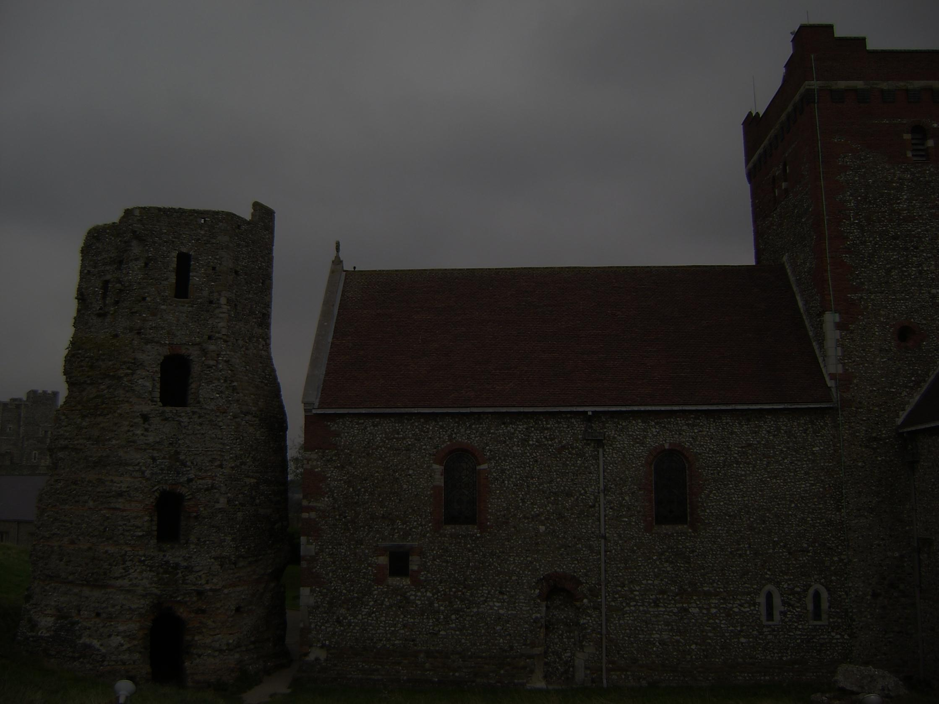
In 595 AD, Pope Gregory I sent Augustine of Canterbury (not to be confused with Augustine of Hippo, the writer of the Confessions and City of God) to Britain as a missionary to the Angles.
Augustine founded the English Church as the first Archbishop of Canterbury. Although there had been Christians in Britain before the 500s, this was the beginning of the primary Christianization of England and English culture.

Slide 5
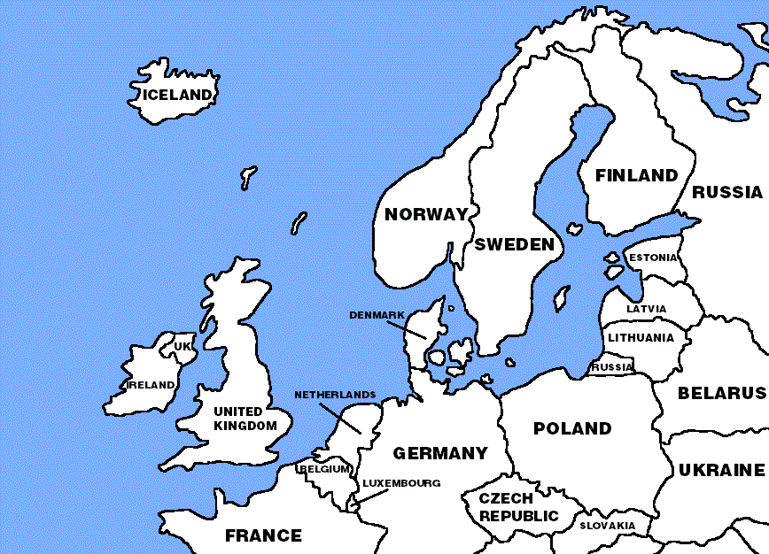
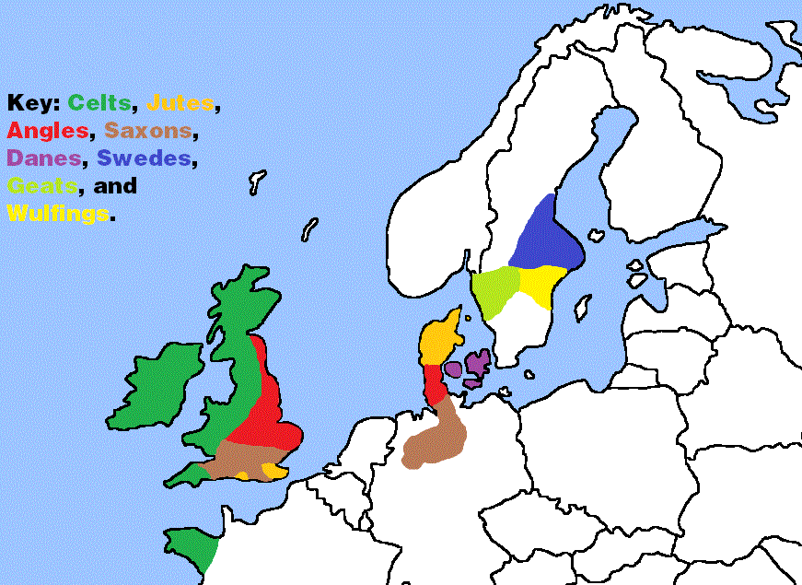

Slide 6
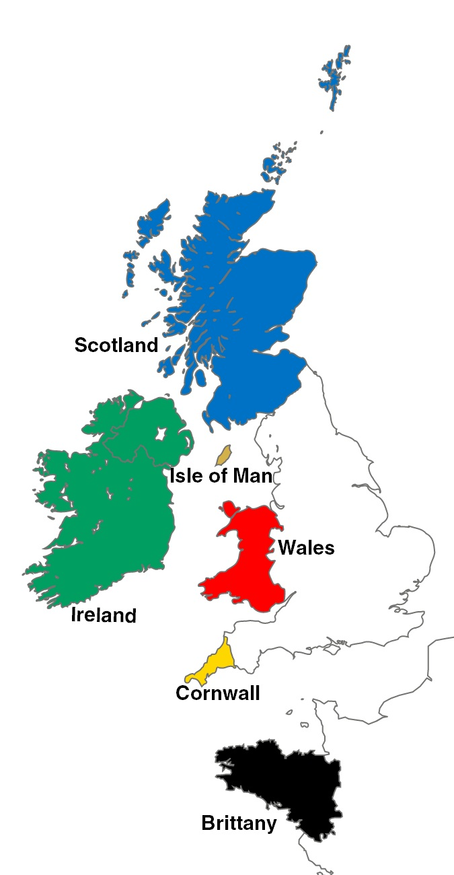
Six Celtic Nations
People | Language | Place | Speakers
Irish | Irish (Gaelic) | Ireland | 2 million
Scottish | Scottish Gaelic | Scotland | 92,000
Manx | Manx | Isle of Man | 100
Welsh | Welsh | Wales | 770,00
Cornish | Cornish | Cornwall (part of England) | 3,500
Breton | Breton | Brittany | 206,000

Slide 7
The English Language
Old English
Beowulf
Unknown
Middle English
The Canterbury Tales
Geoffrey Chaucer
Early Modern English
Macbeth
William Shakespeare
Modern English
Pride and Prejudice
Jane Austen

Slide 8
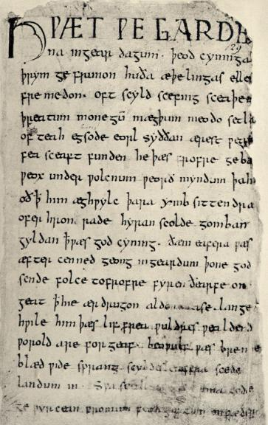
Hwæt. We Gardena in gear-dagum,
þeodcyninga, þrym gefrunon, hu ða æþelingas ellen fremedon.

Slide 9
Translator | Translation
Literal Translation | What. We of the Spear-Danes in old days of the people-kings, power heard, how the princes brave deeds did.
R. M. Liuzza (2000) | Listen! We have heard of the glory in bygone days of the folk-kings of the spear-Danes, how those noble lords did lofty deeds.
Burton Raffel (1963—Textbook) | Hear me! We've heard of Danish heroes, Ancient kings and the glory they cut For themselves, swinging mighty swords!
Seamus Heaney (2001) | So. The Spear-Danes in days gone by and the kings who ruled them had courage and greatness. We have heard of these princes' heroic campaigns.
Michael Alexander (2003) | Attend! We have heard of the thriving of the throne of Denmark, how the folk-kings flourished in former days, how those royal athelings earned that glory.

Slide 10
Great Writers Inspire: Beowulf
Beowulf Audio:
http://writersinspire.podcasts.ox.ac.uk/content/beowulf-0
Beowulf Video:
http://podcasts.ox.ac.uk/beowulf-video

