Slide 1
To Kill a Mockingbird
BY: HARPER LEE

Slide 2
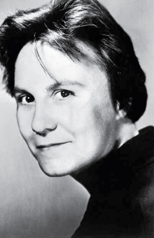
About the Author & Novel
Harper Lee was born in 1926 and is still living
To Kill a Mockingbird, written in 1960, was the only novel she ever wrote
She based the book after her own childhood. The character of “Dill” is based off of her childhood best friend Truman Capote.
  Truman Capote (1924-1984): American author (“Breakfast at Tiffany’s)
The novel won the Pulitzer Prize for Fiction (1961) and the Presidential Medal of Freedom (2007)
http://en.wikipedia.org/wiki/Harper_Lee
http://www.neabigread.org/books/mockingbird/mockingbird04.php

Slide 3
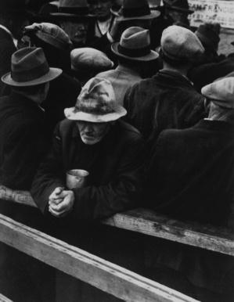
Historical Background
The novel takes place in a time span of three years during the Great Depression.
Businesses failed, people were poor…everyone struggled.
Slavery ended in 1864 but there was prejudice and racial segregation…Old ideas were slow to change (especially in the Deep South where the book takes place).

Slide 4

Setting
Novel takes place in the fictional town of Maycomb, Alabama.
Takes place during the Great Depression
The town of Maycomb is a quiet, small town in the Deep South that is split by racial prejudice.

Slide 5
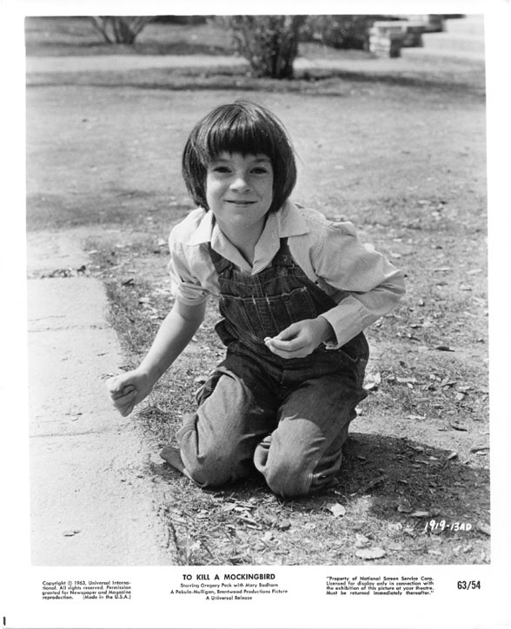
Point-of-View
First person:
  Story is told by Scout, a 10-year-old girl
  Scout represents the author as a little girl although the story is not strictly autobiographical.

Slide 6
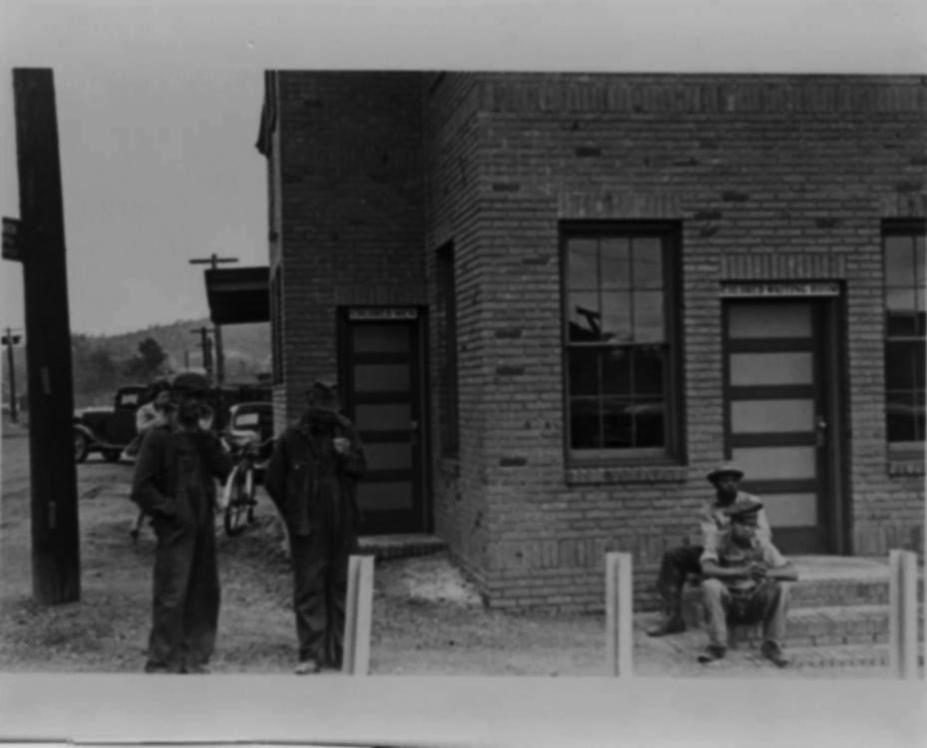
How to Read the Novel
Setting is all important –be aware of the
“where” and “when” as you begin
Point of View – the novel is shaped by the voice of a young girl who sees the story from a position of naïve acceptance
“Goodness vs. Ignorance (Evil)” is an important theme

Slide 7
The Finch Family
Jean Louise Finch (“Scout”) – a six-year-old tomboy who is very intelligent, stubborn, imaginative, and caring. We view the story through her eyes.
Jeremy Atticus Finch (“Jem”)- Scout’s older brother and friend. Jem is curious and industrious…and always up to something.
Atticus Finch – Scout and Jem’s calm and wise father. Atticus is a widowed lawyer who chooses to represent a black man in court. (this causes a controversy)

Slide 8
Other Important Characters…
Charles Baker “Dill” Harris – an adventuresome boy that Jem and Scout befriend. Dill is very good at making up unbelievable tales and play acting.
Calpurnia – a black woman who keeps house for the Finch family. She is the perfect example of “tough love” for Jem and Scout who she has helped raise.
Arthur “Boo” Radley- the mysterious and reclusive neighbor with whom Jem, Scout, and Dill are obsessed.
Tom Robinson- a black man accused of rape. Atticus represents him in court.

Slide 9
Important Context
GENDER BIAS
Women were considered “weak”
Men are not considered capable of nurturing children
LEGAL ISSUES
Juries were MALE and WHITE
A “fair trial” did not include acceptance of a black man’s word against a white man’s word

Slide 10
Themes
Prejudice (takes on many forms in the novel such as: race, gender, handicaps, rich/poor, age, and religion)
Importance of Education
Inequality (finances, age, gender, race)
Coexistence of Good and Evil
Appearance vs. Reality
Bravery

Slide 11
Your Opinion…
Next to each statement put a “1” if you strongly agree, a “2” if you somewhat agree, a “3” if you somewhat disagree, and a “4” if you strongly disagree.
All men are created equal.
Girls should act like girls.
It’s okay to be different.
Nobody is all good or all bad.
Some words are so offensive they should never be stated or written.
Under our justice system, all citizens are treated equal by the court system.
The old saying, “Sticks and stones may break my bones, but words will never hurt me,” is true.
Speaking with proper grammar proves that a person is smart.
No one is above the law.
Education is the great equalizer.
When the law should not succeed in punishing criminals, citizens should do so.

Slide 12
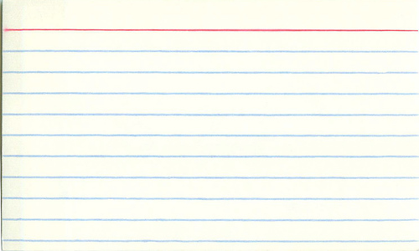
Vocab Cards
Back
Definition:
Synonym/Antonym:
Original Sentence:
Visual Example:
Front
Vocabulary Word
Part of Speech

Slide 13
Vocab Cards Example
Back
Definition: puzzled; confused
Synonym/Antonym: bewildered, enlightened
Original Sentence: He looked perplexed by the questions on the test.
Visual Example:
Front
Perplexed
Adj. (adjective)

Slide 14
Character Cards
Character Name
(First, Last, Nickname)
As you read, focus on the actions and words of the character. Write their name on the front, and on the back add actions, words, qualities, relationships (especially to Scout).
Relationships
Actions/Words
Qualities

