Slide 1
A Tale of Two Cities
by Charles Dickens

Slide 2
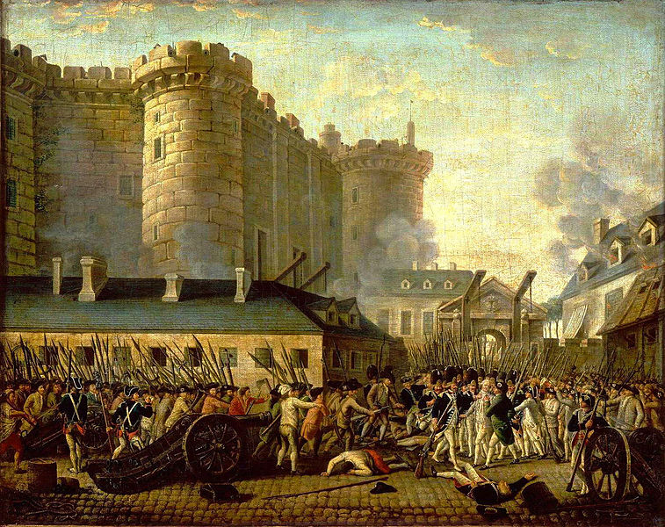
The
French
Revolution

Slide 3
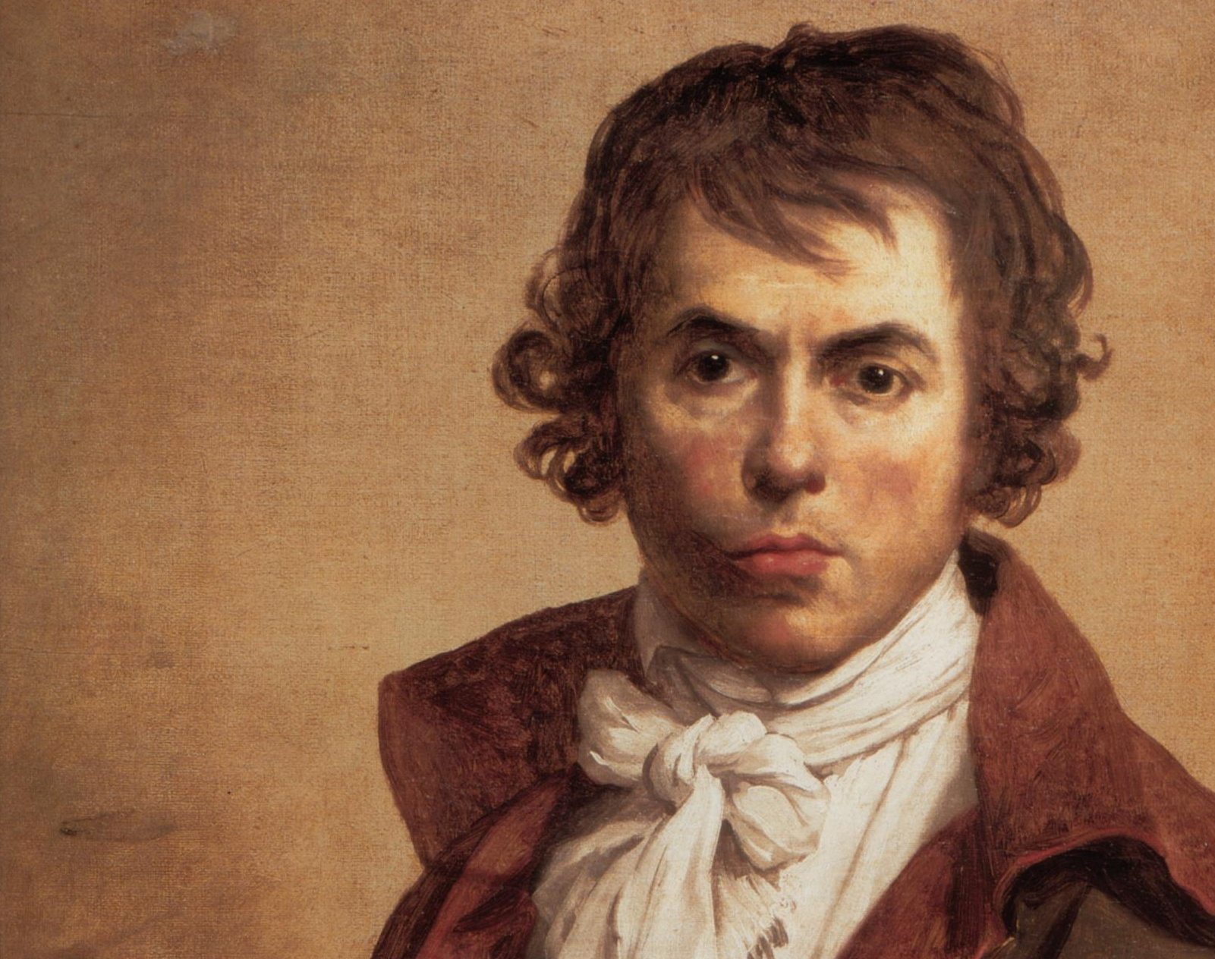
Jacques-Louis David (1748-1825)
David was the foremost artist during the French Revolution and in the Neoclassical style. He lived through the entire French Revolution and the Napoleonic era.

Slide 4
The French Revolution
King Louis XVI called the Estates-General to find a solution to tax problems:
  Three Estates:
    First Estate: Clergy, 0.5% of population
    Second Estate: Nobility, 2% of population
    Third Estate: Everyone else, 97.5% of population

Slide 5
The Estate General of 1789
The representatives of the Third Estate, wanting a republican government, declared themselves to be a National Assembly.
These delegates made an oath (The Tennis Court Oath) that they would create a constitution, ending the absolute monarchy in France.

Slide 6
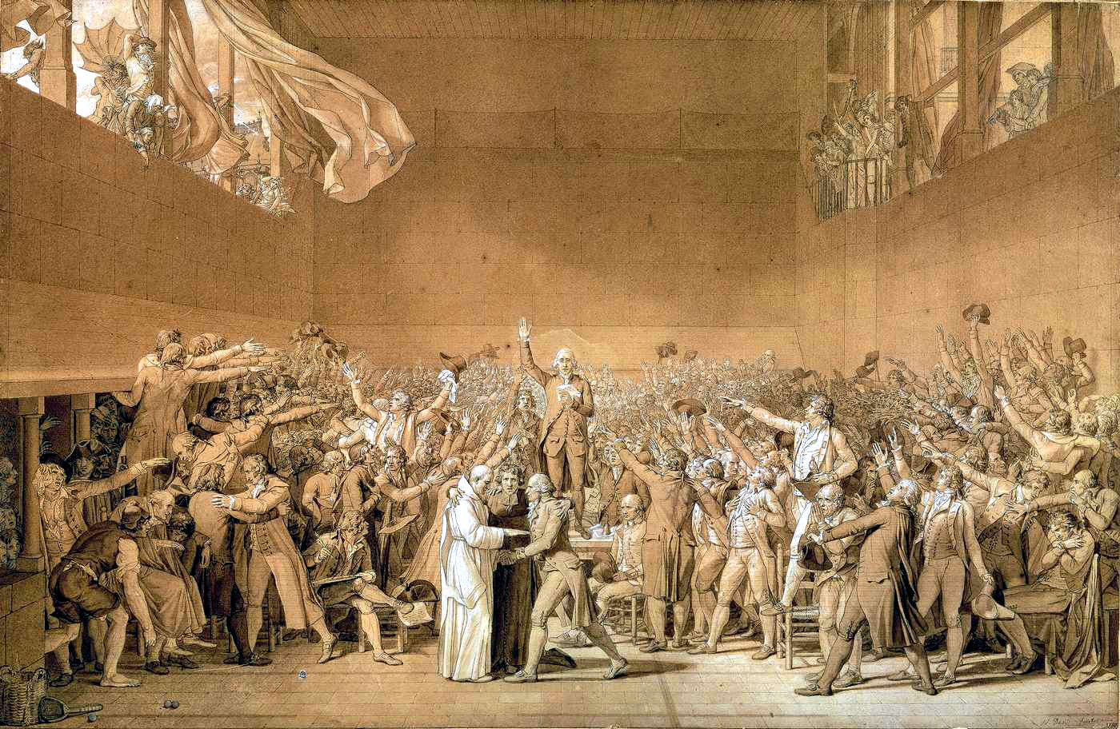
Jacques-Louis David, The Tennis Court Oath

Slide 7
Escalation of the French Revolution
The Storming of the Bastille on 14 July 1789 is the first major violent act of the Revolution. The Bastille was a royal prison that represented the King’s power in Paris.
Revolutionaries solidify power over the next couple of years, eventually executing the King in 1793.

Slide 8
The Reign of Terror
Two major factions of revolutionaries (the Jacobins and the Girondists) begin fighting with each other later in 1793.
Maximilien Robespierre, leader of the Jacobin party, took power.
Between September 1793 and July 1794, tens of thousands of people were executed by guillotine.

Slide 9
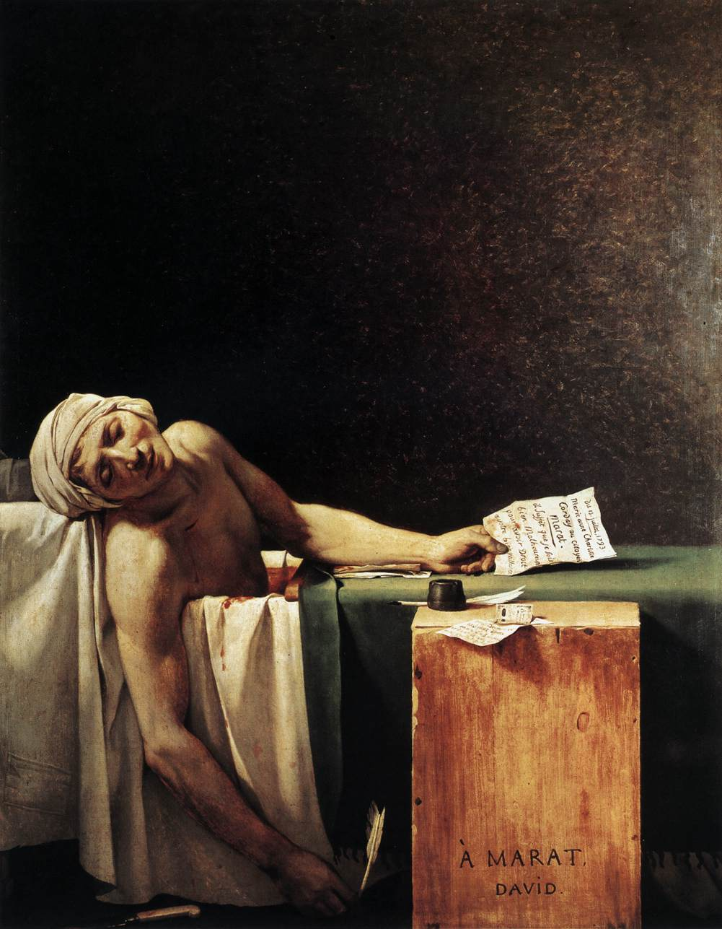
Jacques-Louis David, The Death of Marat, 1793
Marat, a journalist of the Jacobin faction, was murdered in his bathtub by a Girondist in 1793.

Slide 10
Later French Revolution
The Thermidorean Reaction was a period of the fall of Robespierre’s power. He was executed in 1794.
The moderate Directory period from 1795 to 1799 was opposed by remaining radical Jacobins and royalists.
In 1799, Napoleon Bonaparte took control of the French government.

Slide 11
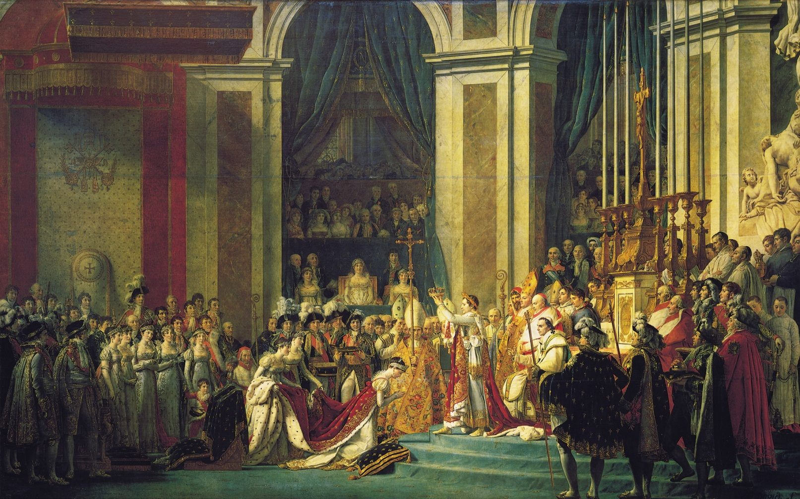
Jacques-Louis David, The Coronation of Napoleon, 1804

Slide 12
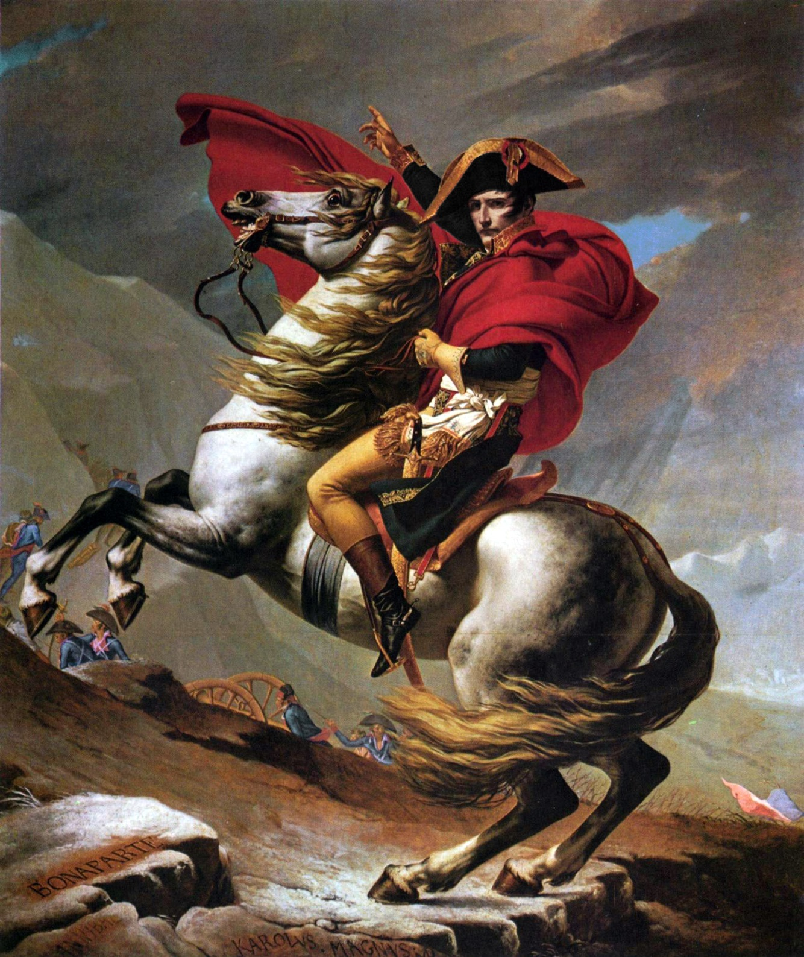
Jacques-Louis David, Napoleon at the Saint-Bernard Pass, 1801
Napoleon led his army into Italy in 1800 through the Saint-Bernard Pass. Napoleon conquered much of Europe in the early 1800s, but was opposed and eventually defeated by a coalition led by the British and Austrians.

Slide 13
England of the 1850s
The Crimean War (1853-1856) was the most significant European war between the Napoleonic Wars (1803-1815) and World War I (1914-1918).
Prime ministers in the 1850s came from four different parties, including the first from the Liberal party (which advocated classical liberalism or laissez-faire).
  Laissez-Faire: the economy works best if private industry is not regulated and markets are free

Slide 14
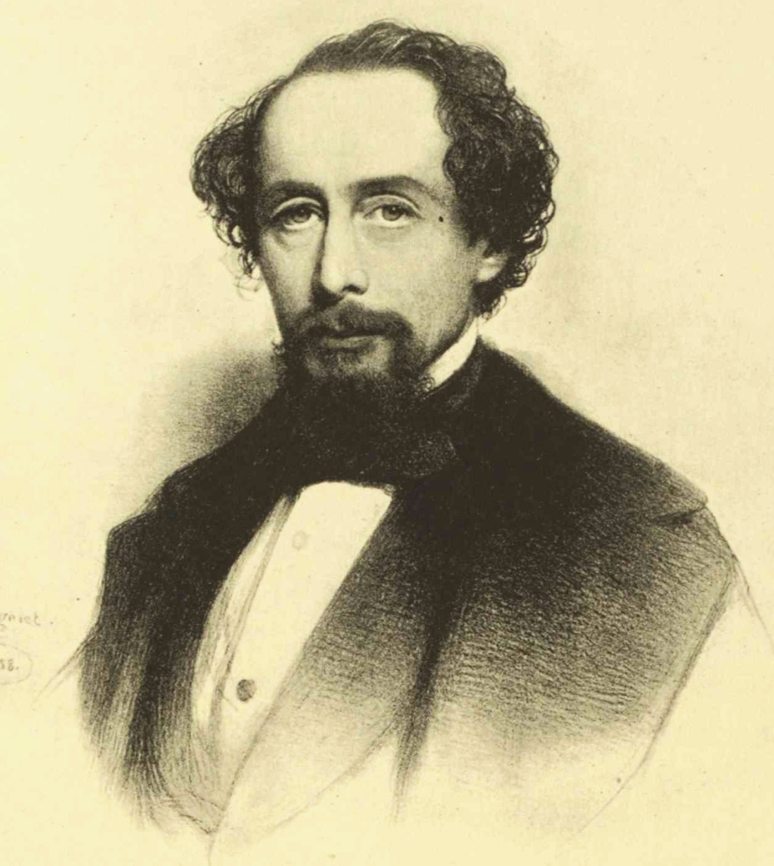
Charles Dickens
b. 1812 in Portsmouth
d. 1870. Buried in Westminster Abbey
Wrote novels, short stories, plays, and non-fiction
Very popular during his time
Created characters from his own experiences and observations while walking around London

Slide 15
Charles Dickens’ Childhood
Came from a poor family
Father sent to debtor's prison
Worked in a factory as a child
Didn’t see his family often
He expressed feelings of humiliation, loneliness, and rejection in the children of his novels

Slide 16
Serial Novels
Chapters of the novel were published in monthly magazines
Allowed authors to refine the novel based on popular taste
Chapters generally ended with a cliffhanger

Slide 17
Major Works
The Pickwick Papers (1836-7)
The Adventures of Oliver Twist (1837-9)
Nicholas Nickleby (1838-9)
A Christmas Carol (1843)
David Copperfield (1849-50)
Bleak House (1852-1853)
Hard Times (1854)
A Tale of Two Cities (1859)
Great Expectations (1860-1)

Slide 18
A Tale of Two Cities
Published in weekly serial form between April 20, 1859, and November 26, 1859
When Dickens published this novel, he may have been the most popular author of his time and throughout the Victorian Age.
“It was the best of times, it was the worst of times . . . it was the season of Light, it was the season of Darkness, it was the spring of hope, it was the winter of despair . . .” —from A Tale of Two Cities

Slide 19
Background for A Tale of Two Cities
Based on Thomas Carlyle’s history of the events during the French Revolution.
Many events in the novel actually took place.
Dickens may have been “influenced by Carlyle’s belief that the revolution was inspired by the centuries of cruelty and poverty the French poor had to endure at the hands of the corrupt nobility.”
  Dickens shows the violence of the French Revolution.
  The violence of overthrowing a government leads to more violence.

Slide 20
A Tale of Two Cities
Setting:1775–1793 in London & Paris
  Some of the story takes place earlier, as told in the flashback.
    Flashback: “Reveals something that happened before that point in the story or before the story began. It provides information to help explain key events in the story.” (Glencoe)
Narrator: Anonymous
  Can be thought of as Dickens
point of view: Third person omniscient
  Omniscient: all-knowing
    Reveals the thoughts, emotions, and motives of the characters
    Comments on the historical events

Slide 21
Themes, Symbols, & Motifs in A Tale of Two Cities
Resurrection
Sacrifice
Violence & Oppression
Doubles
Madame Defarge’s Knitting: vengeance

Slide 22
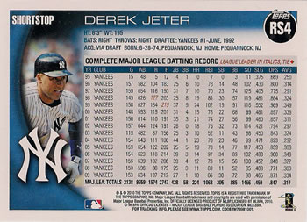

Character Cards
Back:
  Relationships
  Main facts
  Personality
  Important Quotes
  Add Information as you learn more about the character
Front:
  Name
  Sketch (based on description- try to visualize the character)

Slide 23
Create
Character Cards
Important Characters:
  Charles Darnay
  Sydney Carton
  Dr. Manette
  Lucie Manette
  Monsieur Defarge
  Madame Defarge
  Jarvis Lorry
  Jerry Cruncher
  Miss Pross
  Mr. Stryver

Slide 24
A Tale of Two Cities
Novel Vocabulary

Slide 25

Vocab Cards
Back
Definition:
Synonym/Antonym: From the dictionary
Sentence used in the novel:
Visual Example:
Front
Vocabulary Word
Part of Speech

Slide 26
Book the First
EPOCH (period of time) n.
ADJURE (to appeal to; to charge) v.
CESSATION (a ceasing, a stopping) n
LEVITY (lightness, gaiety, frivolity) n.
STOLID (not easily excited) adj.
EXPOSTULATE (to object, to reason earnestly) v.
SUPPLICATORY (beseeching, praying) adj.
FEIGN (pretend) v.
LETHARGY (a state of inaction) n.
SAGACITY (cleverness, wisdom, shrewdness) n.

Slide 27
Book the Second Part I
INVARIABLY (without exception, constantly) adv.
EXTEMPORIZE (improvise, to make without preparation) v.
DEPRECATE (to express disapproval) v.
COGITATE (ponder, think) v.
APHORISM (short pithy sentence, proverb) n.
PERNICIOUS (highly injurious, causing injury) adj.
MALIGN (to speak evil of) v.
LACONIC (concise, terse, brief) adj.
PROPENSITIES (a natural inclination, a liking, a bent, a bias) n.
PROPITIATE (appease, pacify, calm) v.

Slide 28
Book the Second Part II
ELICIT (to draw forth, to evoke) v.
REGENERATION (rebirth) n.
MANIFEST (obvious, clear, plain, evident) adj.
DUBIOUS (doubtful) adj.
RUMINATE (ponder) v.
RECOMPENSE (a return for something, a reward) n.
PRECIPITATE (hurl headlong) adj.
AMICABLE (friendly, peaceable) adj.
ANTECEDENTS (previous history, immediate ancestry) n.
FURTIVE (sly, stealthy) adj.

Slide 29
Book the Third
DOGGEDLY (stubbornly) adv.
BLIGHTED (ruined, withered) adj.
INVIOLATE (unharmed, unimpaired) adj.
JOCOSELY (wittily, jokingly) adv.
PRODIGIOUS (extraordinary, vast) adj.

Slide 30
Sources
Sparknotes: http://www.sparknotes.com/lit/twocities/
The Glencoe Literature Library
Signet Classic Teacher’s Guide

