Slide 1
I. Introduction to Maps & East to Adonia

Slide 2
Journal
Monday
Did you go anywhere for your Christmas Break vacation?
If so, where did you go?
How did you get there?

Slide 3
Maps Brainstorming
Monday
What are maps?
Why do we use maps?
What kinds of maps are there?
How have maps changed from the ancient world to the present?
What technology has affected the accuracy of maps?

Slide 4
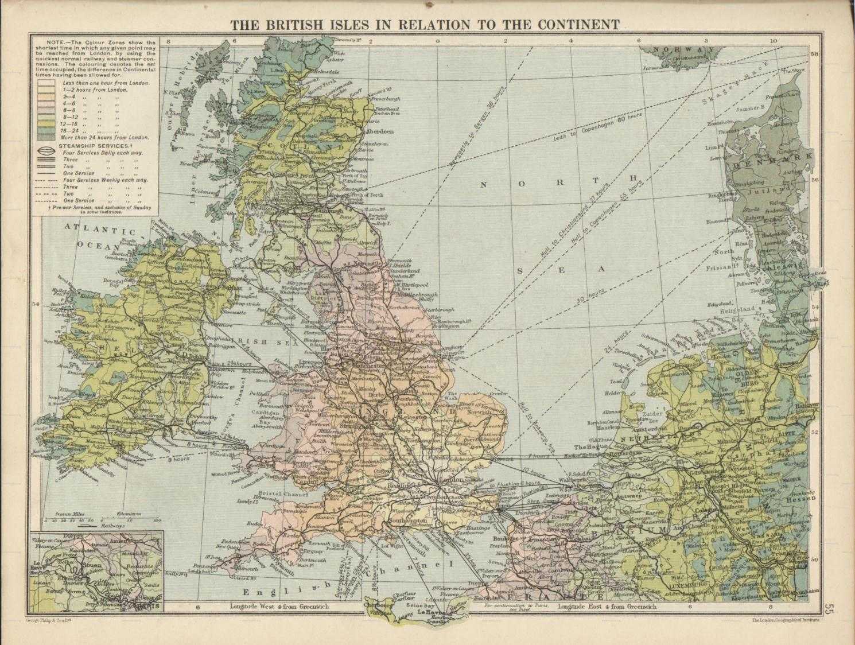
What are maps?

Slide 5
Maps are representations of
some or all of the surface of the Earth (or some other celestial body) or the sky.
They may be accurate depictions, or they may be distorted to convey information in a simpler way.

Slide 6
Figurative Maps:
The Bible (Psalm 119: 105)
“Your word is a lamp to my feet and a light to my path.”

Slide 7
iPad Research
Tuesday
“Cartographer”: definition
Oldest Known World Map
Early World Maps
Tabula Peutingeriana
Find countries
“Pillars of Hercules”
Carta Marina Map
Find sea creatures
Discuss meaning, reality, and purpose
Gerardus Mercator
Distortion:
Ortilelius World Map
"Nova totius Terrarum Orbis" by Hendrik Hondius
Scavenger Hunt

Slide 8
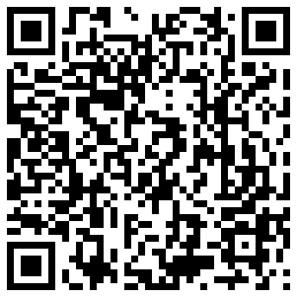
Babylonian Map Imago Mundi (c. 600 BCE) (oldest known world map)
http://upload.wikimedia.org/wikipedia/commons/a/a5/Baylonianmaps.JPG

Slide 9
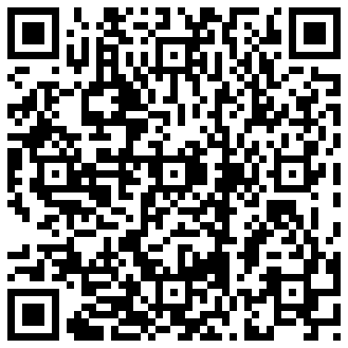
Tabula Peutingeriana (4th Century)
http://upload.wikimedia.org/wikipedia/commons/5/50/TabulaPeutingeriana.jpg

Slide 10
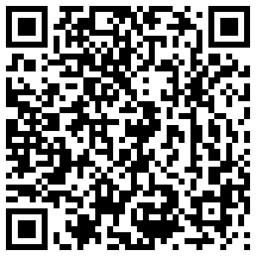
Carta Marina Map (16th Century)
http://upload.wikimedia.org/wikipedia/commons/e/ea/Carta_Marina.jpeg

Slide 11
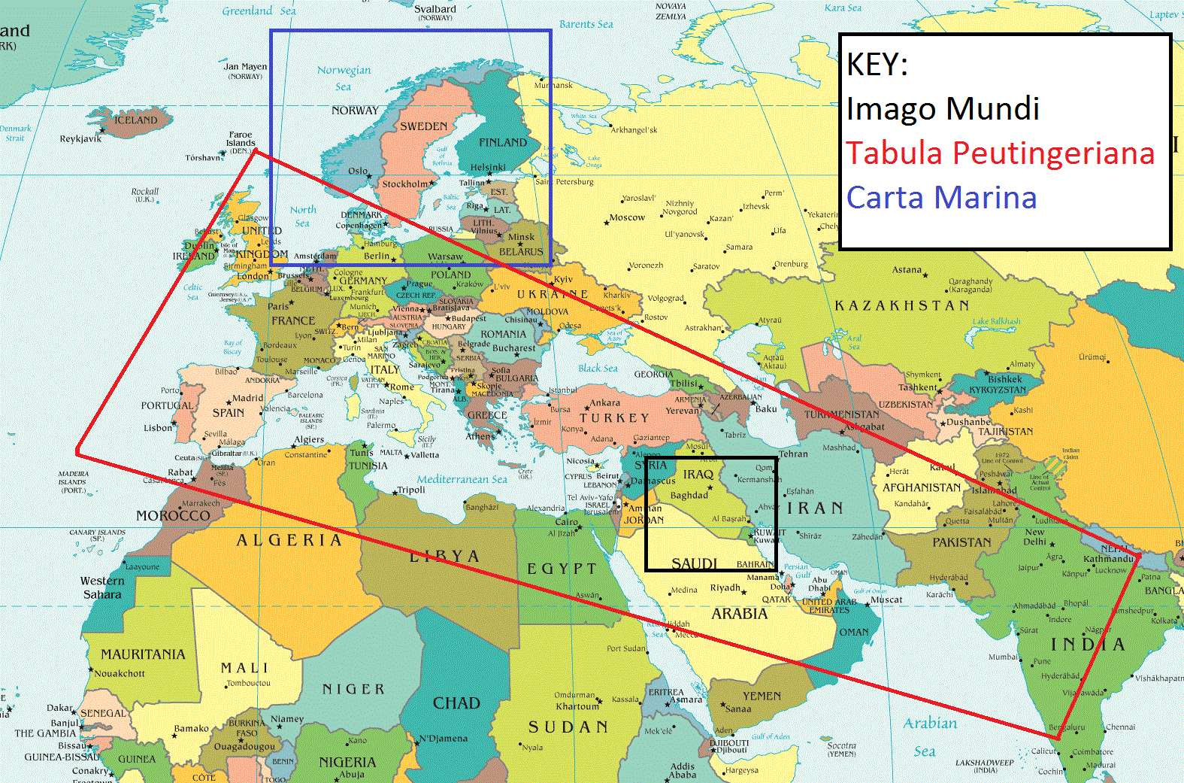

Slide 12
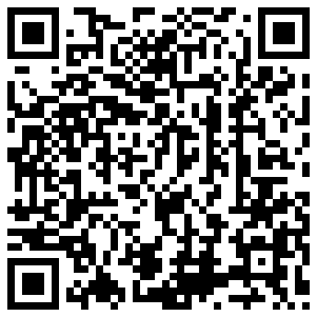
Mercator World Map (1569)
http://upload.wikimedia.org/wikipedia/commons/b/b2/Mercator_1569.png

Slide 13
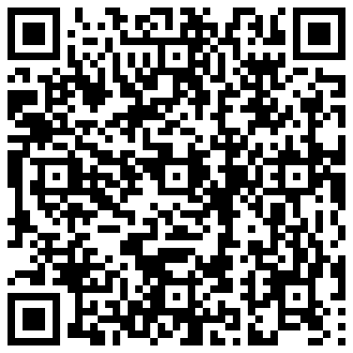
Ortilelius World Map (1570)
http://upload.wikimedia.org/wikipedia/commons/e/e2/OrteliusWorldMap1570.jpg

Slide 14
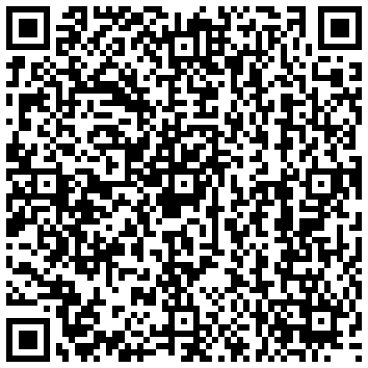
"Nova totius Terrarum Orbis" by Hendrik Hondius (1630)
http://upload.wikimedia.org/wikipedia/commons/b/b5/Nova_totius_Terrarum_Orbis_geographica_ac_hydrographica_tabula_%28Hendrik_Hondius%29_balanced.jpg

Slide 15
2008 Presidential Election (Standard County)

Slide 16
2008 Presidential Election (Cartogram County)

Slide 17
Twitter Language Map of Europe

Slide 18
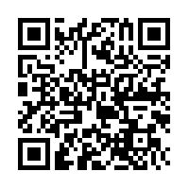
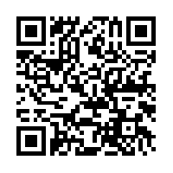
Images of the Social & Economic World
http://www-personal.umich.edu/~mejn/cartograms/

Slide 19
World Maps
Map 1 is a map of the world based on the actual geographic size.
Map 2 is a cartogram in which countries are re-sized based on their population.

Slide 20
Questions
Find a country with a big population, but small land area (more densely populated).
Find a country with a small population, but a large land area (less densely populated).

Slide 21
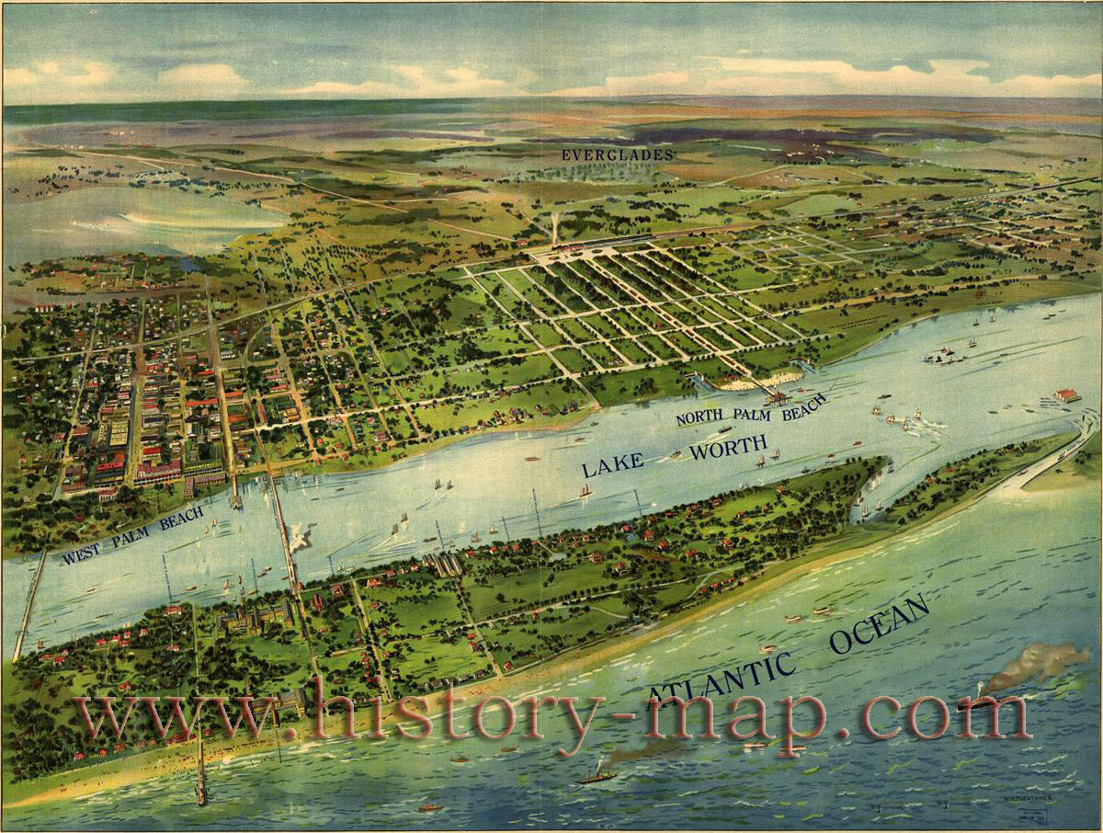
II. Maps in Literature

Slide 22
Wessex
A fictionalized version of southwest England in the Victorian period created by Thomas Hardy (1840-1928).

Slide 25
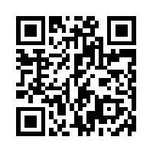
Map 1
http://www.fulltable.com/vts/h/hwess/im/83.jpg

Slide 26
Map 2

Slide 27
Wessex vs. Southwestern England
Person 1 has a map of Thomas Hardy’s Wessex.
Person 2 has a Google Maps location for Dorchester, England. In Wessex, Dorchester is renamed as Casterbridge.

Slide 28
Exercise
Wessex | SW England
Casterbridge | Dorchester
Melchester | ?
Christminster | ?
Exonbury | ?
Wintoncester | ?

Slide 29
Answers
Wessex | SW England
Casterbridge | Dorchester
Melchester | Salisbury
Christminster | Oxford
Exonbury | Exeter
Wintoncester | Winchester

Slide 31
East to Adonia
Author: Jenny Bellington
Protagonist: Mercator Robinson
Overview:
Mercator Robinson can draw maps of anywhere in the world whether he’s been there or not. When his uncle gives him a mapping kit for his twelfth birthday, Mercator is thrown into a strange, fantastic world of pirate, princesses, and magic. Now Mercator has to find his way home out of a world he didn’t know existed. It’s one problem his unique gift hasn’t prepared him for—how to survive when the picture become reality.

Slide 32
http://projects.flowingdata.com/walmart/

