Slide 1
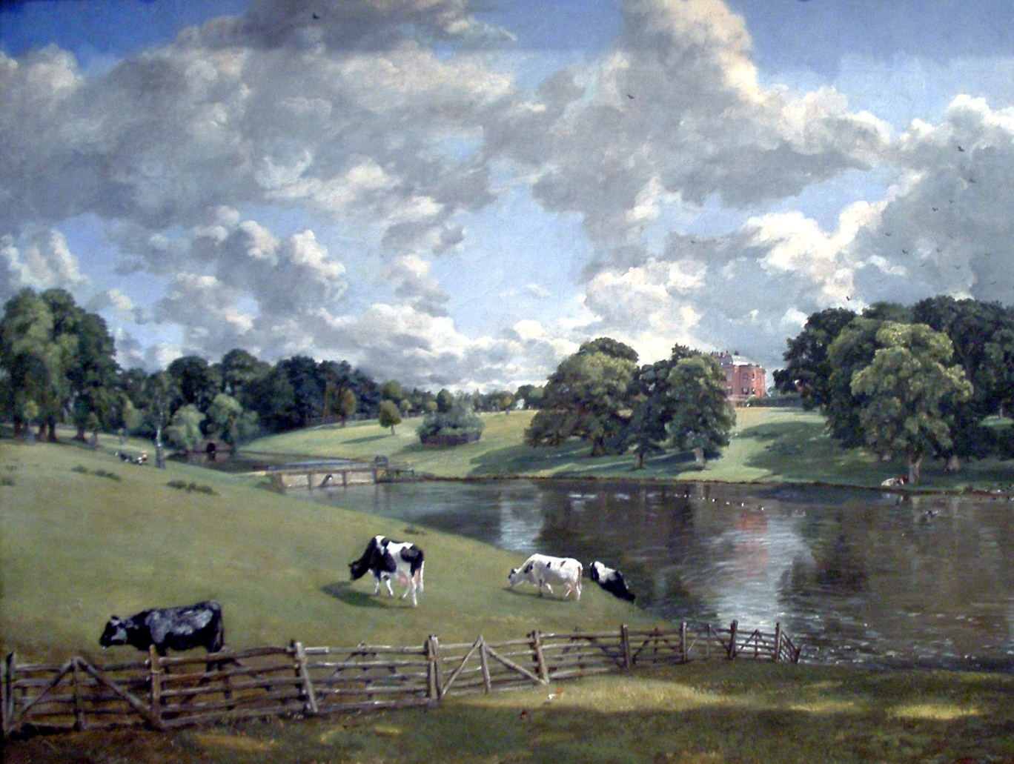
Jane Austen, The Georgian Era, and Pride and Prejudice
John Constable, Wivenhoe Park, Essex, 1816.

Slide 2
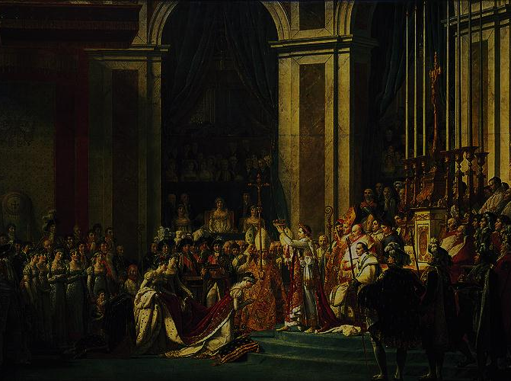
  British and World Events 1798-1832
  1801: Act of Union creates United Kingdom of Great Britain and Ireland
  1801: Union Jack becomes official flag
  1803: United States: Louisiana Territory purchased from France
  1804: Germany: Beethoven composes Symphony No. 3
  1804: France: Napoleon crowns himself emperor
  1805: Battle of Trafalgar
  1813: Jane Austen publishes Pride and Prejudice
  1831: United States: Edgar Allan Poe publishes Poems
    http://www.youtube.com/watch?v=kwRVR-TmKYw
The Coronation of Napoleon is a painting completed in 1807 by Jacques-Louis David

Slide 3




Regency Period Research
What is the Regency Period? Who was in power in England?
How was Austen’s world affected by such international developments as the Napoleonic War, the American Revolution, and the French Revolution?
What elements of popular culture mark this period? Research styles of dress, art, music, dance, and games.
What was the view of women during this time?
Who was Mary Wollstonecraft?
  Suggested Resources:
    http://www.erasofelegance.com/history/regency.html
    http://janeaustensworld.wordpress.com/
    http://www.pemberley.com
    http://www.lkwdpl.org/lhs/regencyperiod/

Slide 4
Explore the following:
Classical Music—for example, Beethoven, Rossini, Schubert, Liszt and Mendelssohn
Dance—Shift in popularity from country dances to the waltz which was considered controversial during Austen’s day
Art—David, Turner, Constable
History—Napoleonic Wars, French Revolution, American Revolution (Note that Austen makes no reference to military actions in this novel, although this was a period of great change through war.)
Science—Industrial Revolution, steam locomotion
Religion—the Evangelical movement, mysticism and other trends in religion during the late 18th and early 19th century
Other areas—architecture, fashion, food, sports

Slide 5
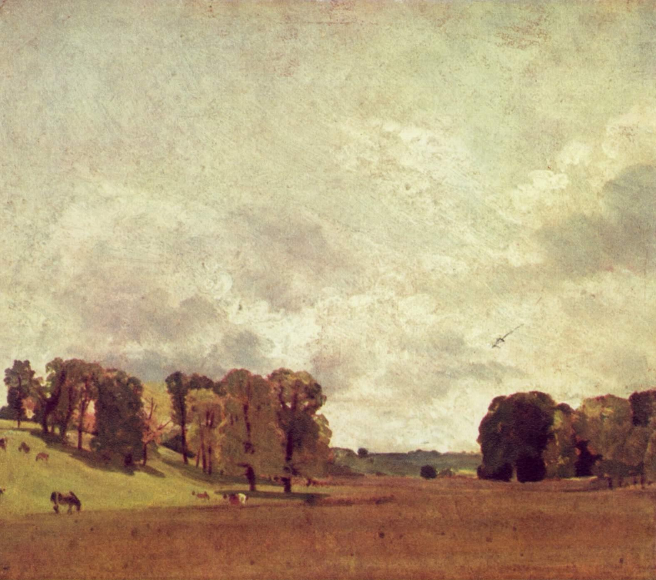
The Georgian Era lasted from 1714 to 1830. It is named after the first four British kings from the House of Hanover, George I, George II, George III, and George IV.
Jane Austen (1775-1817) lived entirely in the reign of George III (r. 1760-1820). Around 1811, George III went insane, and his son (later George IV) ruled in his place until the death of his father, a period known as the Regency.
John Constable, View of Epsom

Slide 6
Dynasty | Monarch | Years
Tudor | Henry VII | 1485-1509
 | Henry VIII | 1509-1547
 | Edward VI | 1547-1553
 | Mary I | 1553-1558
 | Elizabeth I | 1558-1603
Stuart | James I | 1567-1625
 | Charles I | 1625-1649
None | Interregnum | 1649-1660
Stuart | Charles II | 1660-1685
 | James II | 1685-1688
 | William III & Mary II | 1689-1702
 | Anne | 1702-1714
Hanover | George I | 1714-1727
 | George II | 1727-1760
 | George III | 1760-1820
 | George IV | 1820-1830
 | William IV | 1830-1837
 | Victoria | 1837-1901

Slide 7
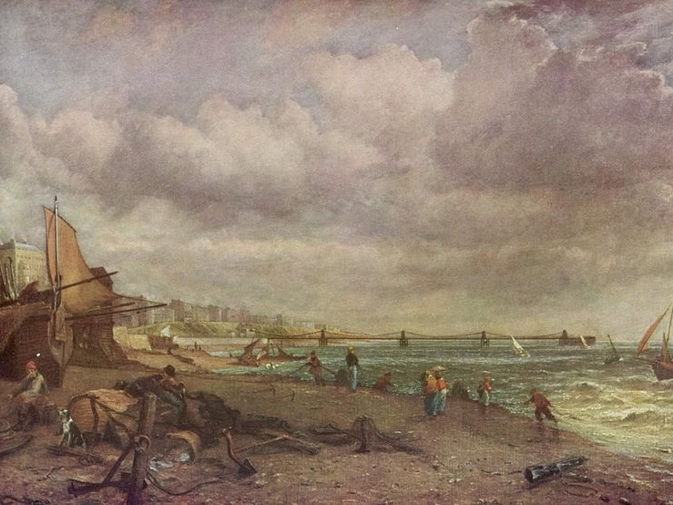
George III (r. 1760-1820)
American War of Independence (1775-1783)
French Revolution (1789-1799)
Napoleonic Wars (1803-1815)
Industrial Revolution (1750-1850)
  Move from agricultural to urban society
  Growth of factories and technology
John Constable, The Chain Pier, Brighton 1824-1827

Slide 8
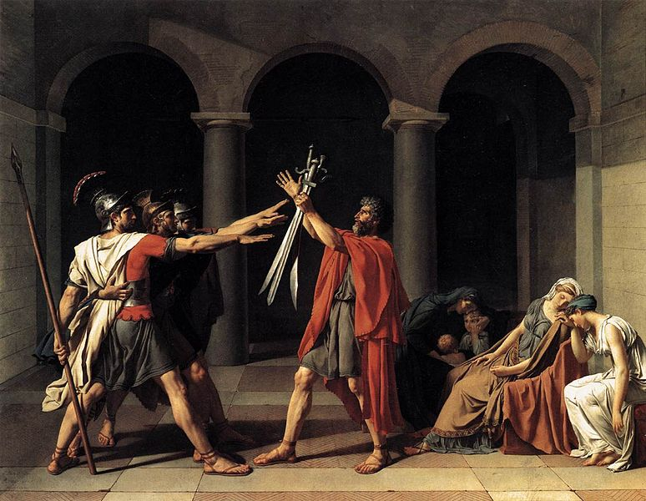
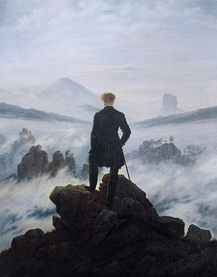
Neoclassicism:
(mid-eighteenth century the middle of the nineteenth century) classical style; order; Enlightenment/Age of Reason
Romanticism:
(early nineteenth century) emotions painted in a bold, dramatic manner; return to nature; against science and reason
Caspar David Friedrich, Wanderer Above the Sea of Fog, 1818
Jacques-Louis David, Oath of the Horatii, 1784

Slide 9
British Painting of the Late Georgian Era
John Constable and J. M. W. Turner are two of the most important English painters of the late Georgian era. They were both important landscape painters, which was less appreciated than history paintings. However, Turner also painted history paintings, such as his Battle of Trafalgar.

Slide 10
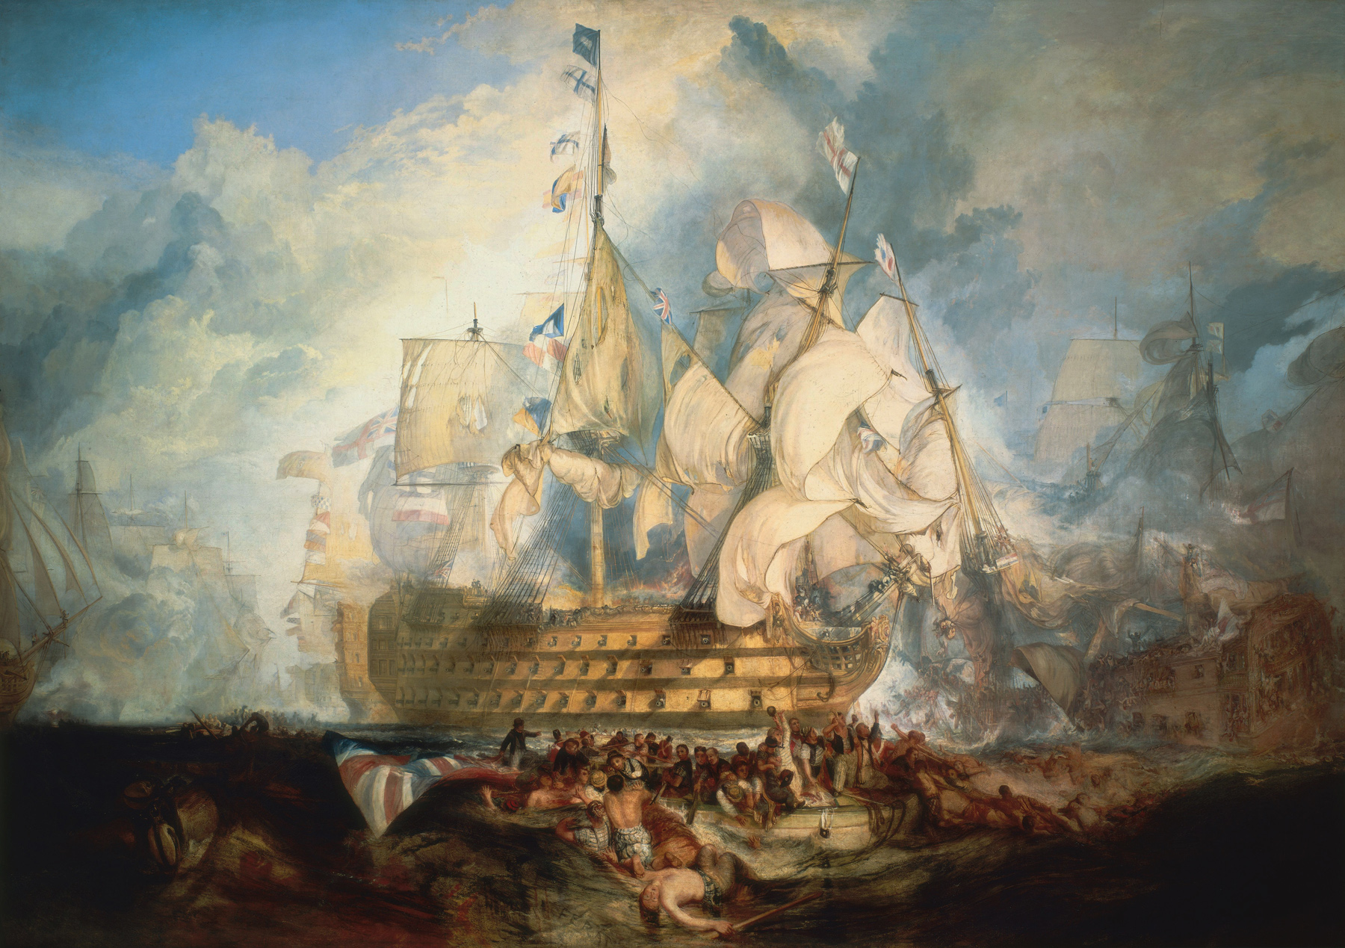
J. M. W. Turner, The Battle of Trafalgar (1822)

Slide 11
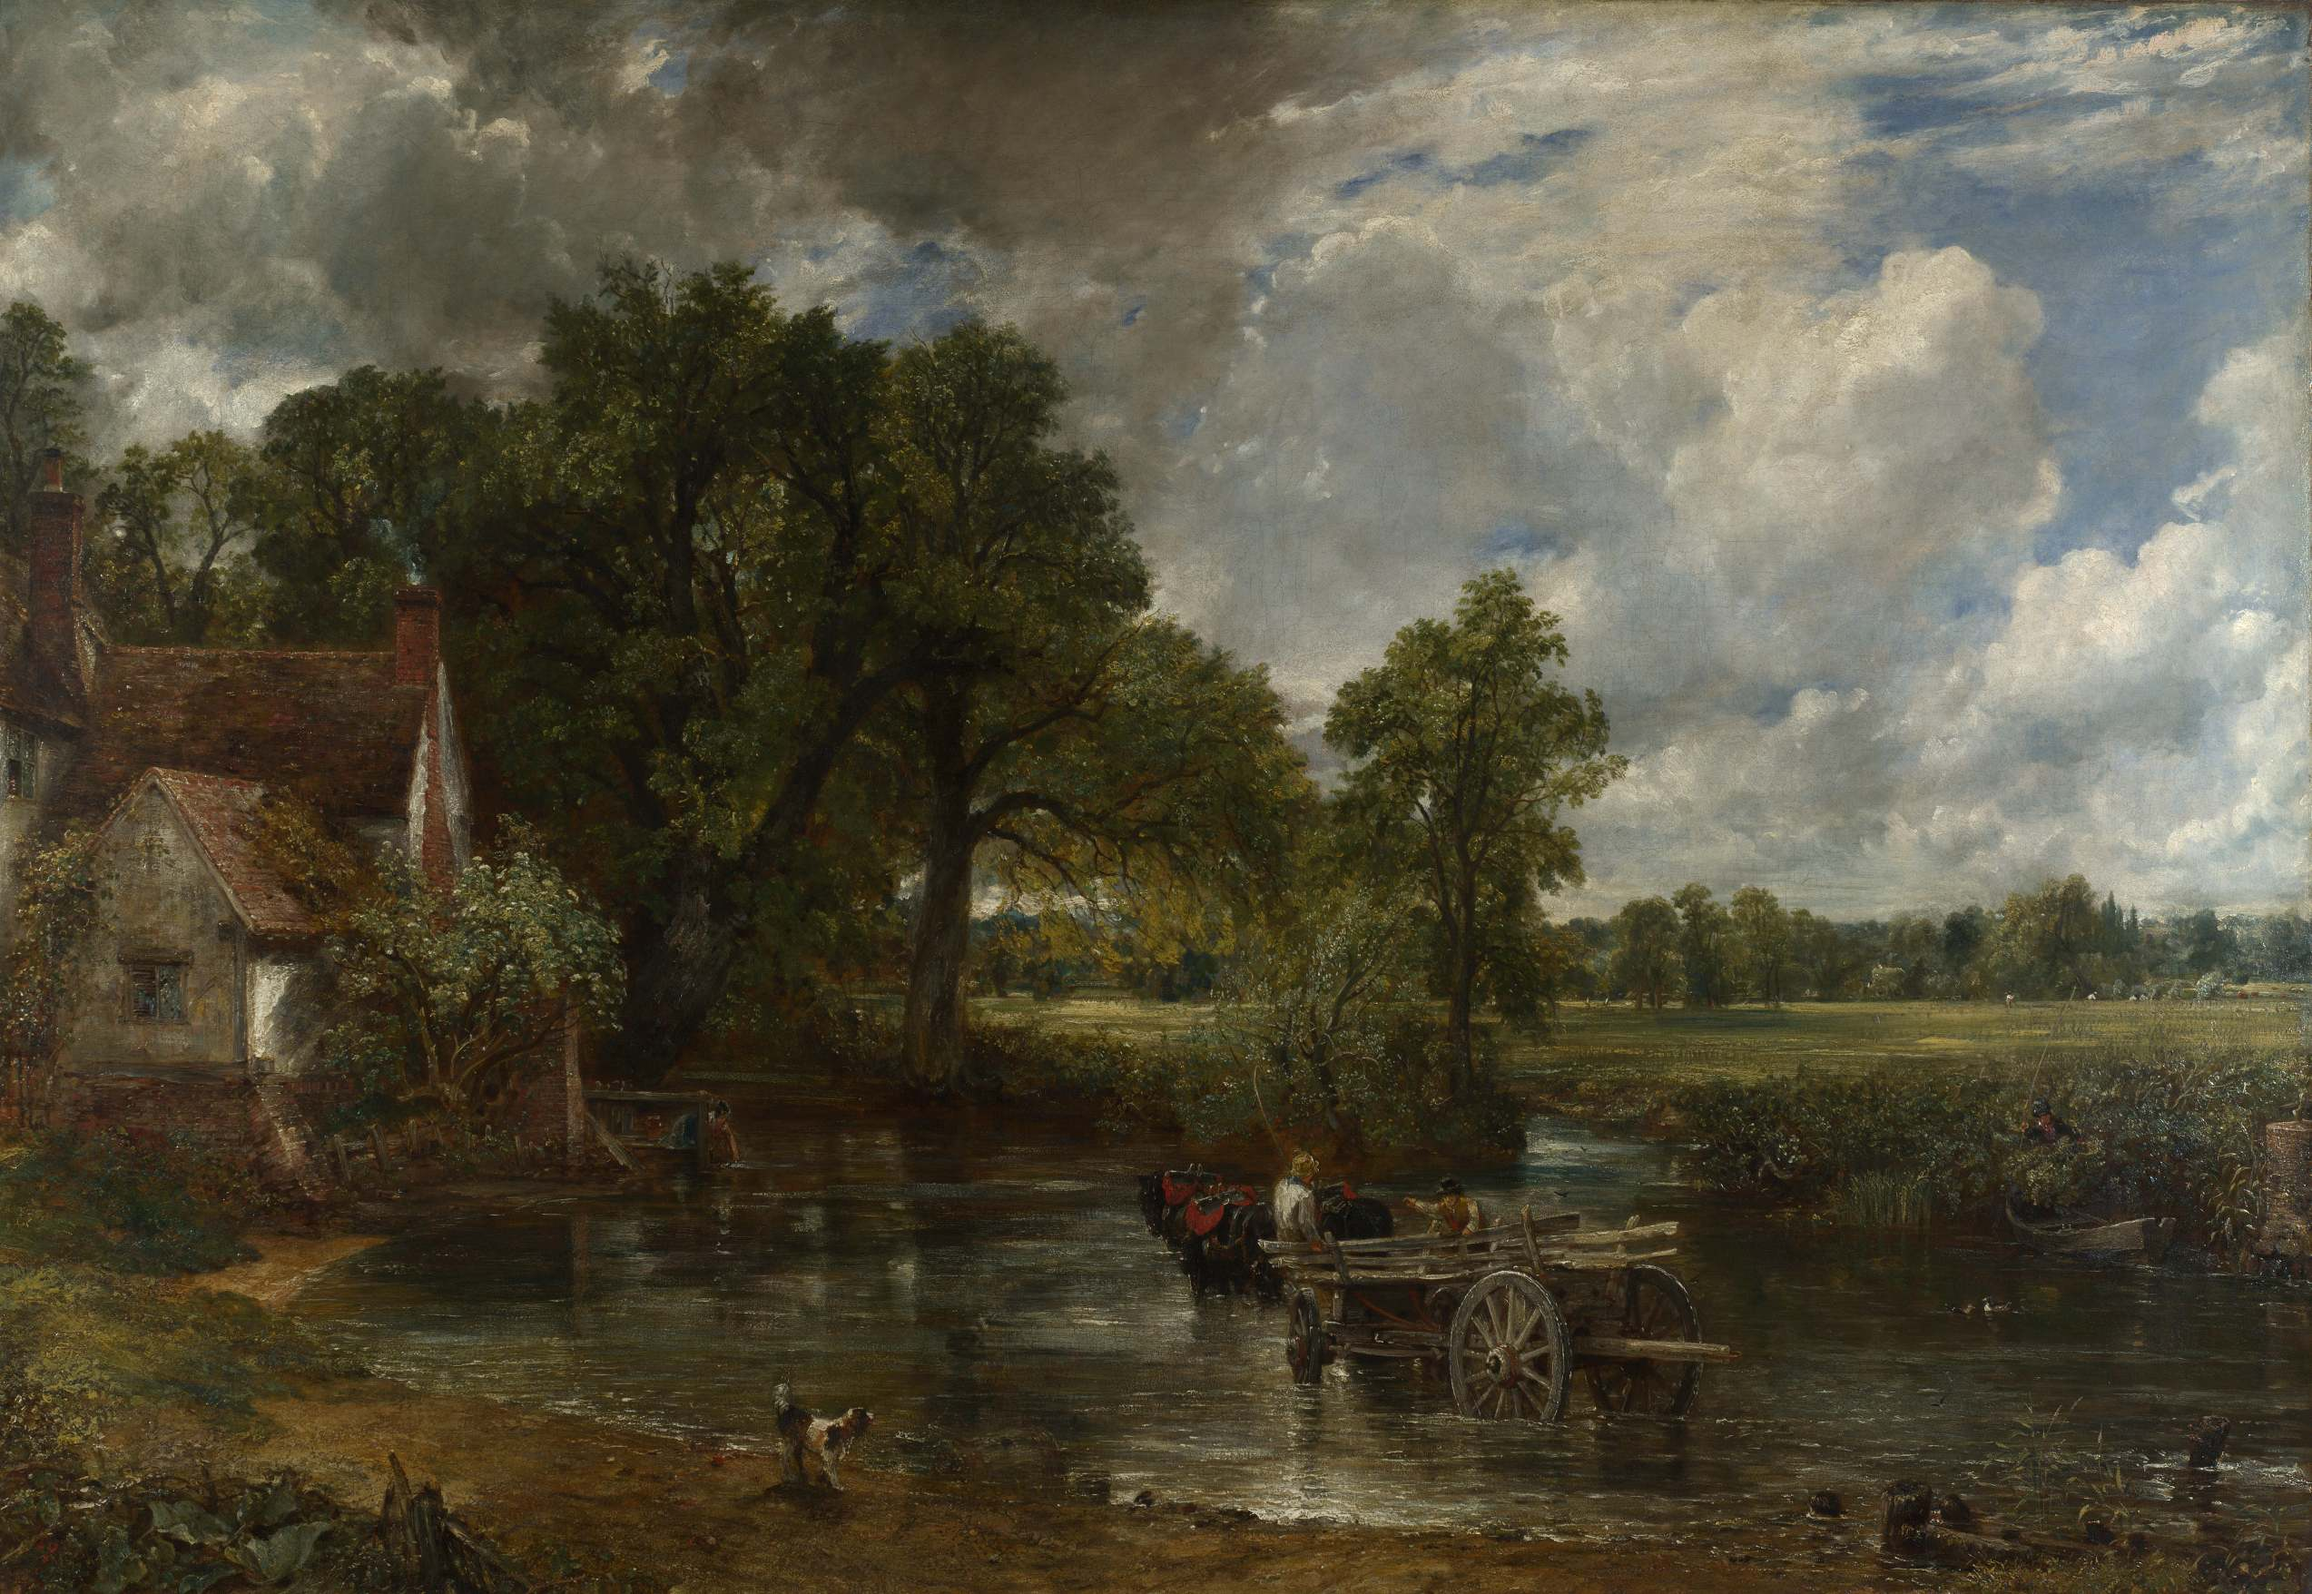
John Constable, The Hay Wain (1821)

Slide 12
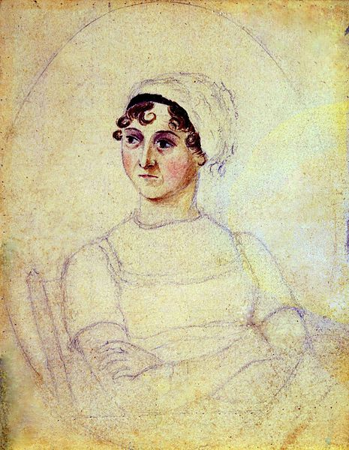
Jane Austen (1775-1817)
Born in Steventon, England
George Austen (father) was the clergyman of the local parish.
She was educated mostly at home by her father with her seven siblings.
Her writing began in her teens with parodies and skits to entertain her family.
A water color and pencil sketch of Austen, believed to have been drawn from life by her sister Cassandra (c. 1810).

Slide 13
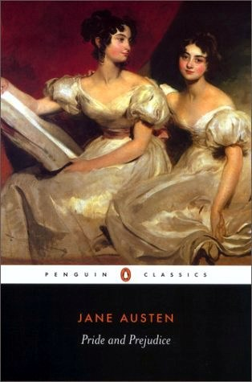
Austen’s Writings
Sense and Sensibility (1811)
Pride and Prejudice (1813)
Mansfield Park (1814)
Emma (1816)
Northanger Abbey and Persuasion were both published posthumously in 1818.
She began a another novel, which was eventually titled Sanditon, but died before completing it.

Slide 14
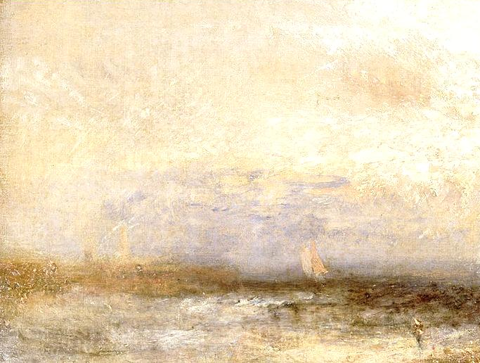
Anonymous Writer
Austen published her novels anonymously, and only her family knew that she was the author of these novels.
  Prevented her from acquiring and authorial reputation, but it enabled her to preserve her privacy.
    English society associated a female’s entrance into the public sphere with a reprehensible loss of femininity.
  Napoleonic Wars (1800-1815) threatened the safety of monarchies throughout Europe, so the government censored literature.
J.M.W. Turner, Off Margate, 1840

Slide 15
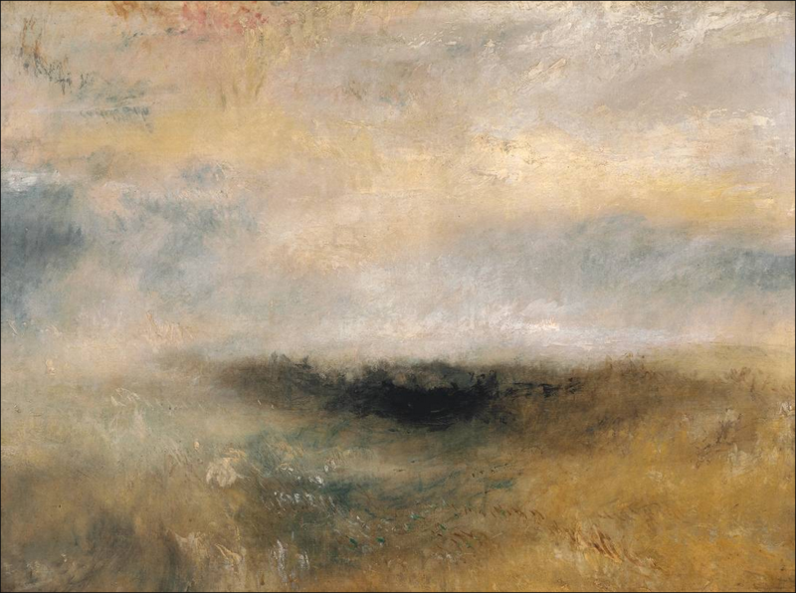
Writing Style
“Novels of Manners” critique social customs, conventions, and behaviors of a particular social class at a specific time and place.
Includes satirical wit (especially in the realities of love and marriage)
  Satirizes snobs and the poor breeding of the lower social classes.
Often critical of the assumptions and prejudices of upper-class England.
Realistic about the lack of social mobility and the awareness of class.
  Advancement for men: military, church, or law
  Advancement for women: successful marriage
J.M.W. Turner, Seascape with Storm Coming On, ca. 1840

Slide 16
Pride & Prejudice
History: originally titled First Impressions (1796-1797)
  Rejected by publishers
  In 1809, Austen began revisions
  Pride and Prejudice published in January 1813
Genre: Comedy of manners (not a tragic ending)
Setting: During Napoleonic Wars (1797-1815) in Longbourn, in rural England
  Netherfield Park, Bingley’s residence
  Pemberly House, Darcy’s Estate
  The Derbyshire countryside
  Rosings, the home of Lady Catherine
Themes: Love, Reputation, Class
J.M.W. Turner, Off Margate, 1840

Slide 17
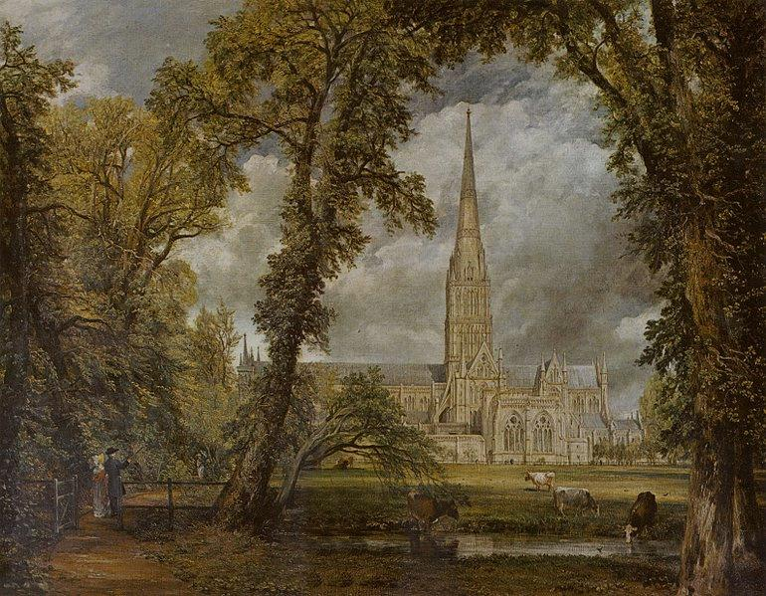
Characters
John Constable, Salisbury Cathedral from the Bishop's Grounds, 1823.
Narrator: Third-person omniscient
Point of View: Elizabeth Bennet (primarily)
Protagonist: Elizabeth Bennet
Antagonist: Snobbish class-consciousness (epitomized by Lady Catherine de Bourgh and Miss Bingley)

Slide 18
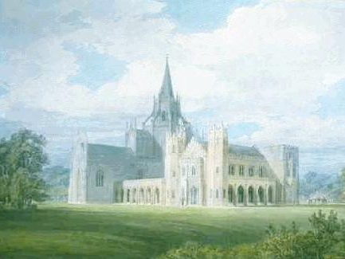
Characters: Bennet Family
Elizabeth Bennet—protagonist, the second of five daughters; pragmatic and independent; her father’s favorite
Miss Jane Bennet—Elizabeth’s older sister; wants to see the best in everyone;
Mary Bennett—the plain, bookish middle sister
Miss Catherine (Kitty) Bennett—easily led and shallow fourth daughter
Lydia Bennet—the youngest sister, flirty and undisciplined
Mr. Bennet—their father, cynical and permissive
Mrs. Bennet—their mother, whose main goal is to find husbands for her daughters
Fonthill Abbey in Wiltshire, England from the south west by J.M.W. Turner, 1799.

Slide 19
Characters: Bennet Friends
Charlotte Lucas—Elizabeth’s best friend
Sir William and Mrs. Lucas—The Bennets’ neighbors
Mr. Collins—the Bennet girls’ overbearing cousin, a priggish clergyman who stands to inherit Longbourn, the Bennets’ entailed estate
The Gardiners—Mrs. Bennet’s brother and sister-in-law who live in London
George Wickham—an attractive militia officer stationed near the Bennets
Fonthill Abbey in Wiltshire, England from the south west by J.M.W. Turner, 1799.

Slide 20
Characters: Bingley Family & Friends
Mr. Charles Bingley—unmarried, wealthy young man who has leased nearby Netherfield
Miss Caroline Bingley—Mr. Bingley’s sister
Mrs. Hurst—Bingley’s married sister
Mr. Hurst—Bingley’s brother-in-law
Mr. Fitzwilliam Darcy—Bingley’s prideful, wealthy friend
Miss Darcy—Darcy’s sister
Col. Fitzwilliam—a relation of Darcy whose status as second son leaves him with little wealth
Lady Catherine de Bourgh—a condescending wealthy snob; patron of Collins; aunt of Darcy
Fonthill Abbey in Wiltshire, England from the south west by J.M.W. Turner, 1799.

Slide 21
Character Cards
Elizabeth Bennet
Miss Jane Bennet
Miss Catherine (Kitty) Bennet
Lydia Bennet
Mr. Bennet
Mrs. Bennet
Charlotte Lucas
Mr. Collins
George Wickham
Mr. Charles Bingley
Mr. Fitzwilliam Darcy
Lady Catherine de Bourgh
Fonthill Abbey in Wiltshire, England from the south west by J.M.W. Turner, 1799.

Slide 22
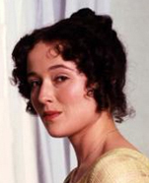
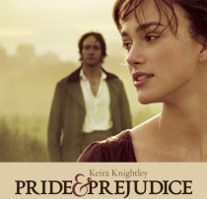

Character Cards
Character Name
(First, Last, Nickname)
As you read, focus on the actions and words of the character. Write their name on the front with a visual example, and on the back add actions, words, qualities, relationships (especially to Elizabeth Bennet).
Relationships
Actions/Words
Thoughts/Others’ Thoughts
Qualities

Slide 23
Vocab Cards
Back
Definition:
Synonym/Antonym:
Original Sentence:
Visual Example:
Front
Vocabulary Word
Part of Speech

Slide 24
Vocab Cards Example
Back
Definition: puzzled; confused
Synonym/Antonym: bewildered, enlightened
Original Sentence: He looked perplexed by the questions on the test.
Visual Example:
Front
Perplexed
Adj. (adjective)

Slide 25




Pride & Prejudice Research:
1
Pride and Prejudice Economics: Or Why a Single Man with a Fortune of £4,000 Per Year is a Desirable Husband
A Pride and Prejudice Gazetteer : A Guide to the Real and Imagined Places in the Novel
JASNA: Where’s Where in Jane Austen’s Novels
The History of the Novel
2
http://janeaustensworld.wordpress.com/2008/02/10/the-economics-of-pride-and-prejudice-or-why-a-single-man-with-a-fortune-of-4000-per-year-is-a-desirable-husband/
http://www.pemberley.com/images/landt/maps/pp/Cary-1812-Eng-map.html
3
http://www.jasna.org/info/maps.html
4
http://www.nvcc.edu/home/ataormina/novels/history/default.htm

Slide 26
  Pre-Reading Questions:
    First impressions are often wrong.
    Children are rarely justified in being embarrassed by their parents.
    Parents should have some say about whom their children marry.
    Families should be concerned with what others think.
    Love at first sight is a common occurrence.
    People communicate more effectively in the twenty-first century than they did during the nineteenth century.
    “Happiness in marriage is entirely a matter of chance” (Charlotte, 21).
    Playing “hard to get” is useful in attracting members of the opposite sex.
    People are happiest when they marry within their own social class.
John Constable, View of Epsom

