Slide 1
Poetry and Art
Artwork

Slide 2
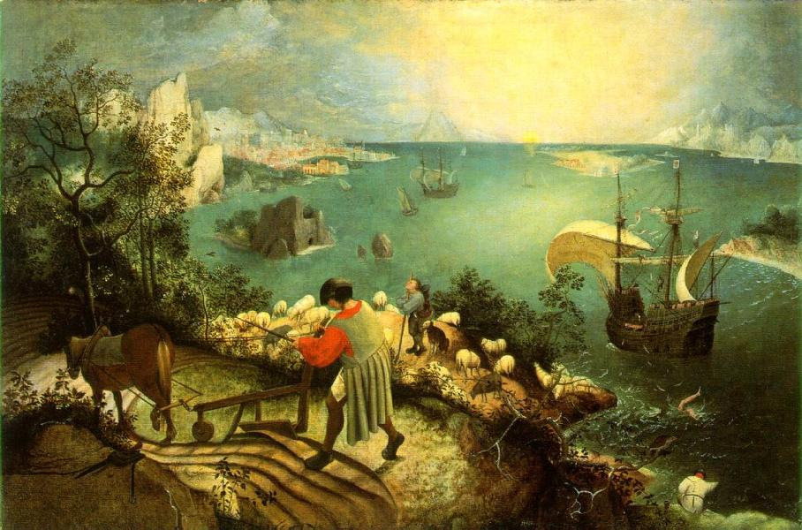
Pieter Breugel the Elder, Landscape with the Fall of Icarus (c. 1558)

Slide 3
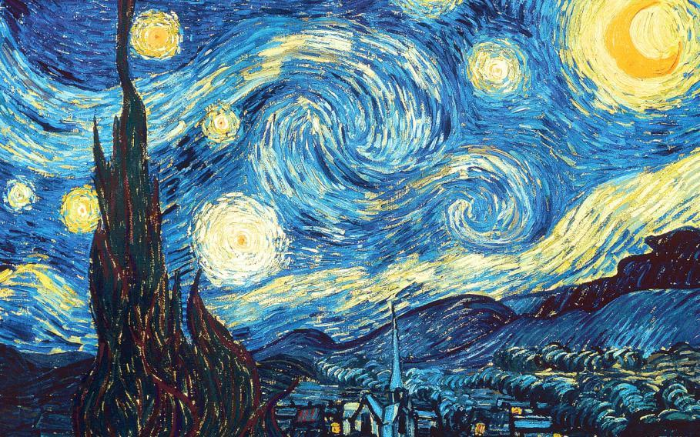
Vincent van Gogh, The Starry Night (1889)

Slide 4
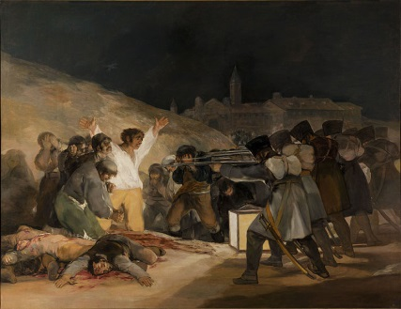
Francisco de Goya, The Third of May, 1808: The Execution of the Defenders of Madrid (1814)

Slide 5
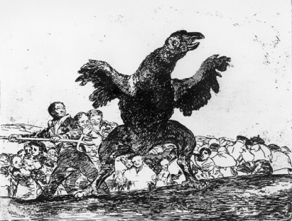
Francisco de Goya, The Disasters of War, the Carnivorous Vulture (c. 1810)

Slide 6
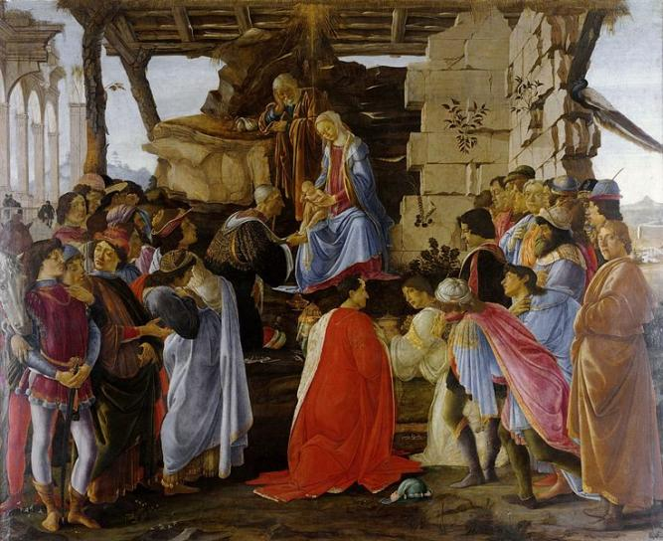
Sandro Botticelli, Adoration of the Magi (c. 1475)

Slide 7
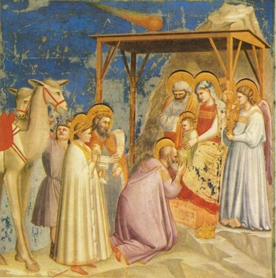
Giotto di Bondone, Adoration of the Magi (1313)

Slide 8
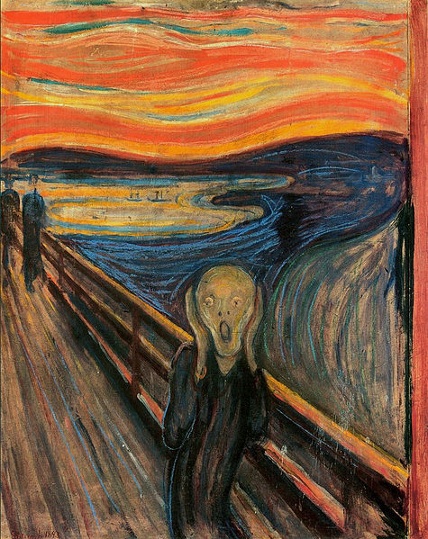
Edvard Munch, The Scream (1893)

Slide 9
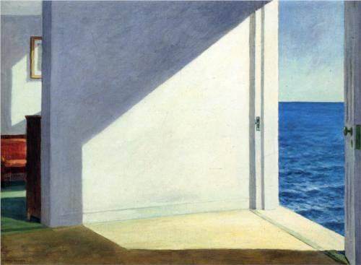
Edward Hopper, Rooms by the Sea (1903)

Slide 10
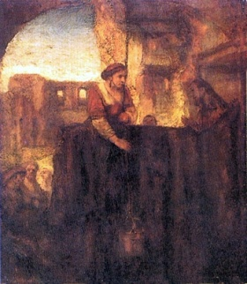
School of Rembrandt Van Rijn, Christ and the Samaritan Woman at the Well (1659)

