Slide 1
Repousse
Vocabulary & Scripture

Slide 2
Project Scripture
Matthew 10:9
Acquire no gold nor silver nor copper for your belts…

Slide 3
Project Vocabulary
REPOUSSAGE: A French word that refers to the craft of embossing metal from the back to create a low relief, 3-D sculpture.
COUNTER REPOUSSE: After first using repousse to indent and emboss a metal surface, counter repousse is the technique of flipping the metal over and working on defining the texture further.

Slide 4
Project Vocabulary
SYMMETRY: A design that is the same on both sides (has a mirror image)
ASYMMETRY: Informal balance/without symmetry. Details and weight of objects in composition are evenly distributed.
PATTERN: A repeated shape or design.
TEXTURE: How something feels (roughness/smoothness)

Slide 5
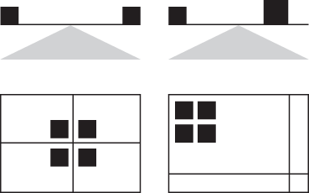
Asymmetrical or Symmetrical?

Slide 6
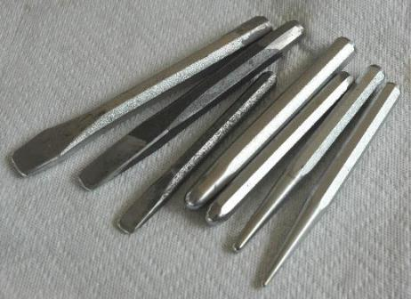
Project Vocabulary: Tools
TOOLING: Creating a 3-Dimensional art form out of a flat sheet of metal.
STYLUS: A tool used to “draw” designs and patterns on metal. The stylus allows you to emboss, or indent, the metal.

Slide 7
Etymology: Repousse
The word repoussé is French and means "pushed up", ultimately from Latin pulsare, which means "to push".

Slide 8
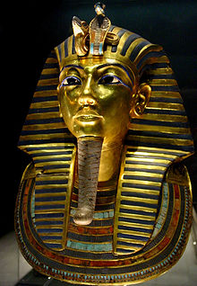
Famous Works
Mask of Tutankhamun's mummy, the popular icon for ancient Egypt at The Egyptian Museum.
Pharaoh of Egypt
Reign ca. 1332–1323 BC

Slide 9
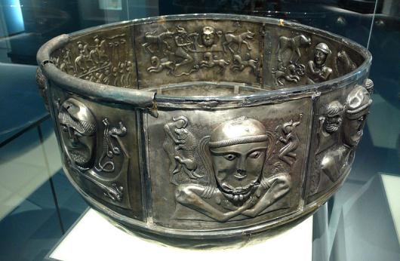
Famous Works
Gundestrup Cauldron
Dates between 200 BC and 300 AD
The cauldron is the largest known example of European Iron Age silver work.

Slide 10
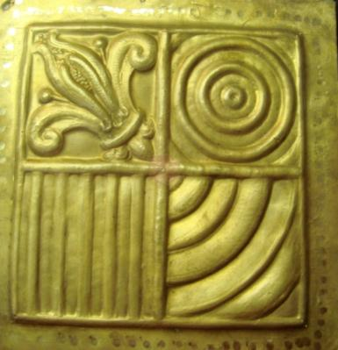
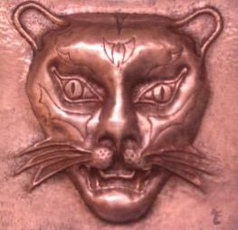
Examples

Slide 11
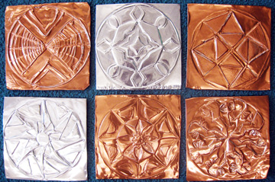
Radial Repousse Examples

Slide 12
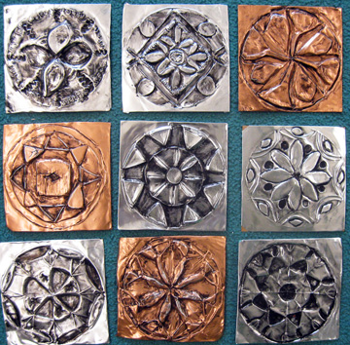
Radial Repousse Examples

Slide 13
Create a Design
Use your ruler to create a 4” by 4” box in your sketchbook.
Then divide your box into 2” by 2” squares.

Slide 14
Create a Design
Only use one box to create your design.

Slide 15
Create a Design
Draw an arrow pointing to the CENTER of your box. This will help you with your radial design.

Slide 16
Create a Design
Cut out your design to trace it onto the metal.

Slide 17
Websites
http://morsearts.wordpress.com/2009/05/
http://www.triangleparkcreative.com/tips/design/principles
http://en.wikipedia.org/wiki/Repouss%C3%A9_and_chasing

