Slide 1
The Canterbury Tales
by Geoffrey Chaucer

Slide 2
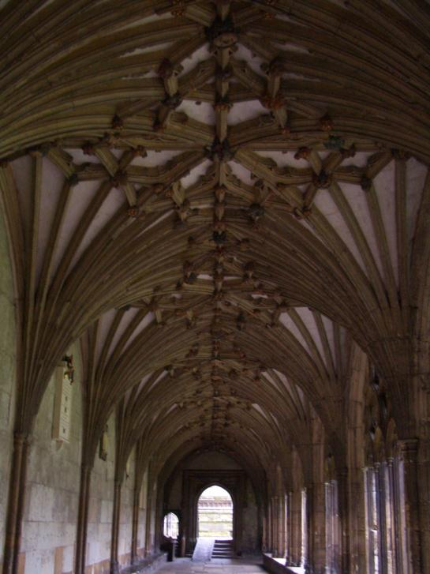
The Canterbury Tales is about a group of 30 pilgrims travelling to visit the shrine of Thomas Becket in Canterbury. Each member of the group tells impressive stories, and the winner, chosen by the narrator, will receive a free meal on the way back.
The work is unfinished, with only the prologue and 24 tales completed.

Slide 3
Thomas Becket (1118-1170)
http://www.sacred-destinations.com/england/canterbury-stained-glass-photos/h-7835c.jpg

Slide 4
In 1133, Henry II becomes King of England. In 1162, Henry appoints Thomas Becket, his Chancellor, to be Archbishop of Canterbury, the head of the Church of England.

Slide 5
Henry assumes that Thomas will support him in his struggles with the Church over wrongdoings by clergy. Henry asserted that the secular courts should judge criminal clergymen, but Thomas defended the use of ecclesiastical courts.

Slide 6
Thomas seemed to take his role as Archbishop seriously. He opposed Henry’s attempt to take more control of the Church.

Slide 7
Four knights heard Henry say “Will no one rid me of this turbulent priest?“ They confronted Becket at Canterbury Cathedral. After Becket refused to give in to the king, they killed him.

Slide 8
In order to prevent excommunication, King Henry accepted three blows from a rod from 80 priests as penance for his disagreements with the Church.

Slide 9
Geoffrey Chaucer (1343-1400)

Slide 10
Geoffrey Chaucer, the author of The Canterbury Tales, was the son of a merchant. He eventually became the page in a noblewoman’s court.
He was recognized by King Edward III for his writings, which gave him financial support and fame.
Upon his death, he was the first person to be buried in the Poets’ Corner of Westminster Abbey in London.
http://static4.depositphotos.com/1014905/306/i/950/depositphotos_3060854-Old-wall-of-stones-of-a-medieval-castle.jpg

Slide 11
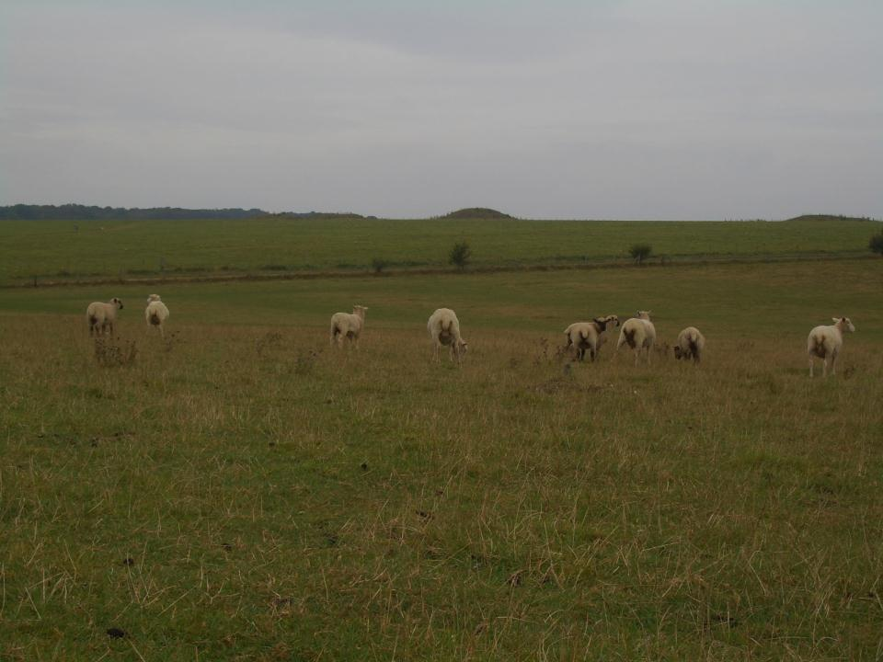
Middle English
Original
In Flaundres whilom was a compaignye
Of yonge folk, that haunteden folye,
As riot, hasard, stywes, and tavernes,
Wher as with harpes, lutes, and gyternes
They daunce and pleyen at dees, bothe day and nyght

Slide 12
Middle English
Original
Modern English
Translation
In Flaundres whilom was a compaignye
Of yonge folk, that haunteden folye,
As riot, hasard, stywes, and tavernes,
Wher as with harpes, lutes, and gyternes
They daunce and pleyen at dees, bothe day and nyght
In Flanders, once, there was a company,
Of young companions given to folly,
Riot and gambling, brothels and taverns;
And, to the music of harps, lutes, gitterns,
They danced and played at dice both day and night.

Slide 13
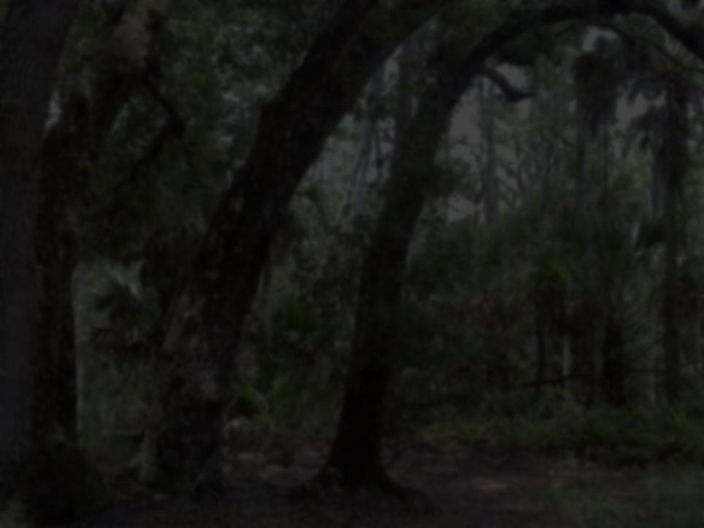
Pardoner
a medieval preacher delegated to raise money for religious works by soliciting offerings and granting indulgences

Slide 14
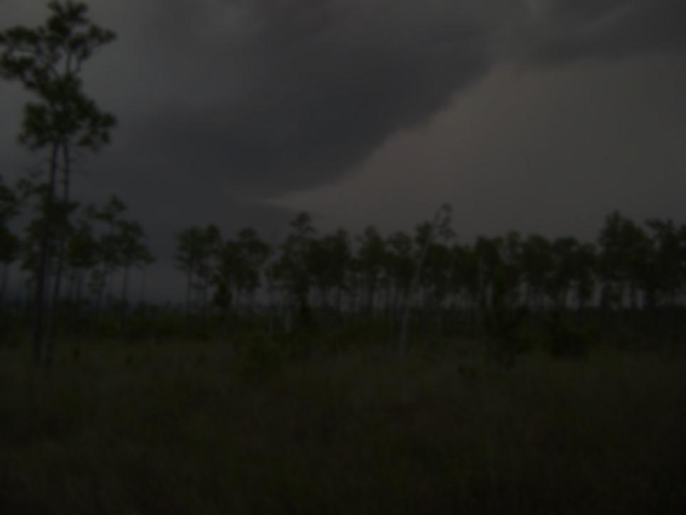
Themes
The Pardoner preaches against greed, yet he himself is greedy. He openly admits to cheating the poor and using pigs’ bones instead of saints’ bones as relics
Chaucer used the Pardoner to affirm his belief in the Church, while opposing some of the practices of the Church.

Slide 15
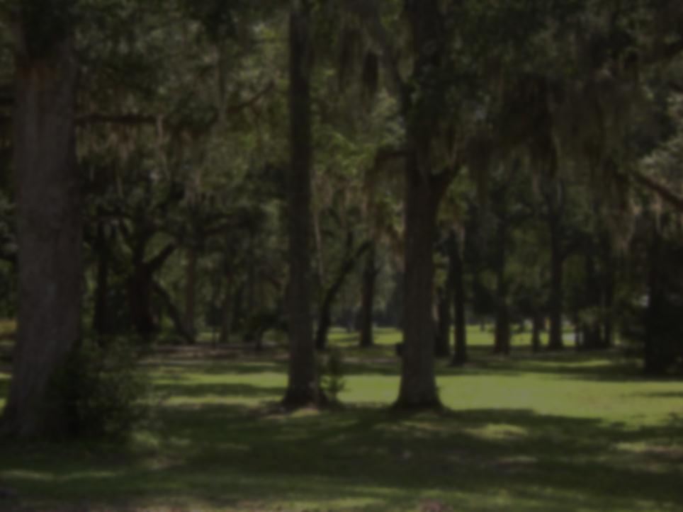
Relic
a part of a deceased holy person's body or belongings kept as an object of reverence.

Slide 16
PLOT
Three drunk men set out from a pub to find and kill Death, whom they blame for the death of their friend, and all other people that previously have died.

Slide 17
An old man they ask tells them that he has asked Death to take him but has failed. He then says they can find death at the foot of an oak tree. When the men arrive at the tree, they find a large amount of gold and forget about their quest to kill Death.

Slide 18
They decide that they would sleep at the tree overnight, so they can take the coins in the morning. The three men draw straws to see who among them should fetch wine and food while the other two wait under the tree. The youngest of the three men drew the shortest straw.

Slide 19
The two plot to kill the other one when he returns, while the one who leaves for the town plots to poison the wine. When he returns with the food and drink, the other two kill him and drink the poisoned wine, dying slow and painful deaths. All three have found death.

