Slide 1
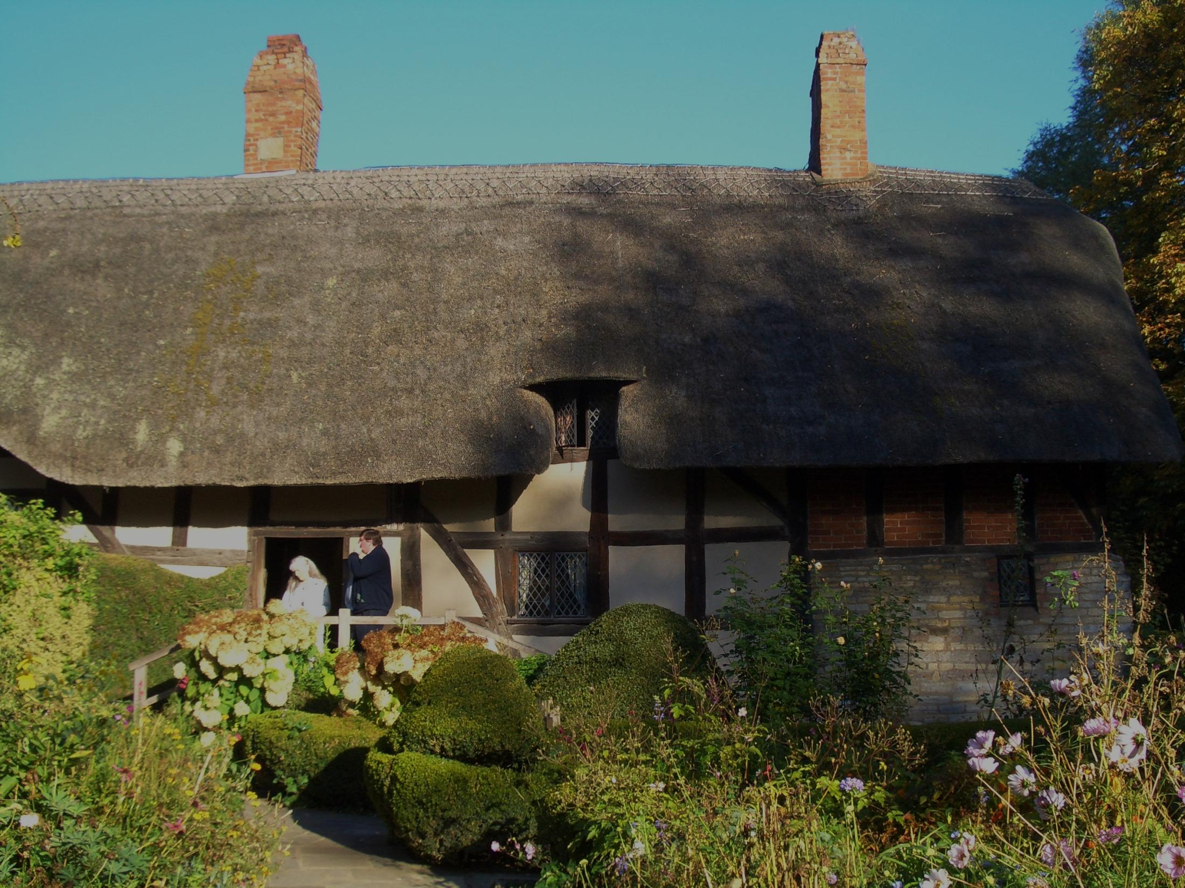
WilliamShakespeare

Slide 2
I was born in 1564 in Stratford-upon-Avon, England. I eventually moved to London, where I wrote over 38 plays and hundreds of poems. I died in 1616.

Slide 3
Shakespeare’s plays are usually divided into three categories: histories, comedies, and tragedies.

Slide 4
Comedies:
All’s Well That Ends Well
As You Like It
The Comedy of Errors
Cymbeline
Love’s Labour’s Lost
Measure for Measure
The Merchant of Venice
The Merry Wives of Windsor
A Midsummer Night’s Dream
Much Ado About Nothing
Pericles, Prince of Tyre
The Taming of the Shrew
The Tempest
Twelfth Night
Two Gentlemen of Verona
The Two Noble Kinsmen
The Winter’s Tale
Tragedies:
Antony and Cleopatra
Coriolanus
Hamlet
Julius Caesar
King Lear
Macbeth
Othello
Romeo and Juliet
Timon of Athens
Titus Andronicus
Troilus and Cressida
Histories:
King John
Edward III
Richard II
Henry IV (1 & 2)
Henry V
Henry VI (1, 2, & 3)
Richard III
Henry VIII

Slide 5
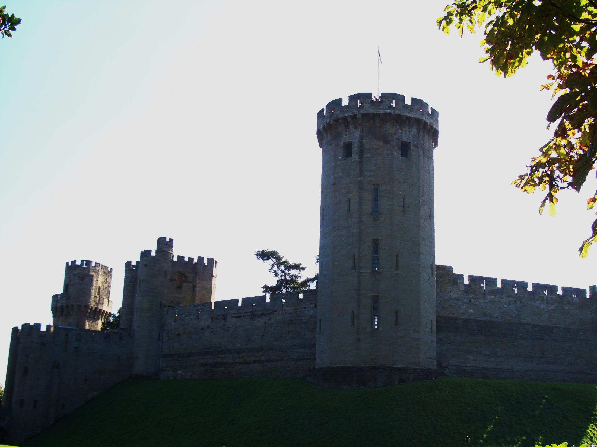
Macbeth

Slide 6
The Real Macbeth
There are few primary sources relating to the real Macbeth. It seems that he ruled for 17 years (1040-1057), and that he died in battle.
Macbeth most likely killed Duncan I, though little is known of the circumstances.

Slide 7
Source for Macbeth
Macbeth of Scotland has very little to do with the title character of Shakespeare’s play.
Shakespeare used Raphael Holinshed’s Chronicles of England, Scotland, and Ireland as his primary source. Later, this source was proved to be inaccurate.
Additionally, Shakespeare adapted this into a tragic play, moving further from the historical truth.

Slide 8
Seventeenth Century Influences
James IV of Scotland became James I of England in 1603, uniting the kingdoms.
On November 5, 1605, a radical Catholic group and Guy Fawkes plotted to blow up the king and Parliament during the opening of Parliament.
This led to increased persecution of Catholics and sympathy for King James.
At the time, it was believed that Banquo was an ancestor of King James. Shakespeare made him an admirable character.

Slide 9
Tragedy
Plays in which disaster befalls a hero or heroine.
Uses rich language and vivid imagery.
How is Macbeth a tragedy?

Slide 10
Soliloquy
From the Latin solus meaning “alone”.
A long speech, usually made by character who is alone.
Reveals private thoughts, feelings, secret desires, or troubling fears to the audience, but not to the other characters.
Examples:
Lady Macbeth’s soliloquy, Act I, Scene v
Macbeth’s soliloquy, Act I, Scene vii

Slide 11
Themes, Motifs, and Symbols
Themes: are the fundamental and often universal ideas explored in a literary work.
Motifs: are recurring structures, contrasts, and literary devices that can help to develop and inform the text’s major themes.
Symbols: are objects, characters, figures, and colors used to represent abstract ideas or concepts.

Slide 12
Themes, Motifs, and Symbols
Ambition
Fate
Violence
Cruelty and Masculinity
Prophecy
Visions and Hallucinations
Blood
Weather

Slide 13
Characters
Macbeth - Macbeth is a Scottish general and the thane of Glamis who is led to wicked thoughts by the prophecies of the three witches, especially after their prophecy that he will be made thane of Cawdor comes true.
Lady Macbeth - Macbeth’s wife, a deeply ambitious woman who lusts for power and position.
The Three Witches - Three “black and midnight hags” who plot mischief against Macbeth using charms, spells, and prophecies.

Slide 14
Characters
Banquo - The brave, noble general whose children, according to the witches’ prophecy, will inherit the Scottish throne.
King Duncan - The good King of Scotland whom Macbeth, in his ambition for the crown, murders.
Macduff - A Scottish nobleman hostile to Macbeth’s kingship from the start. He eventually becomes a leader of the crusade to unseat Macbeth.

Slide 15
Characters
Malcolm - The son of Duncan, whose restoration to the throne signals Scotland’s return to order following Macbeth’s reign of terror.
Hecate - The goddess of witchcraft, who helps the three witches work their mischief on Macbeth.
Fleance - Banquo’s son, who survives Macbeth’s attempt to murder him.
Lennox - A Scottish nobleman.
Ross - A Scottish nobleman.

Slide 16
Characters
The Murderers - A group of ruffians conscripted by Macbeth to murder Banquo, Fleance (whom they fail to kill), and Macduff’s wife and children.
Porter - The drunken doorman of Macbeth’s castle.
Lady Macduff - Macduff’s wife. other than that of Macbeth and Lady Macbeth.
Donalbain - Duncan’s son and Malcolm’s younger brother.

Slide 17
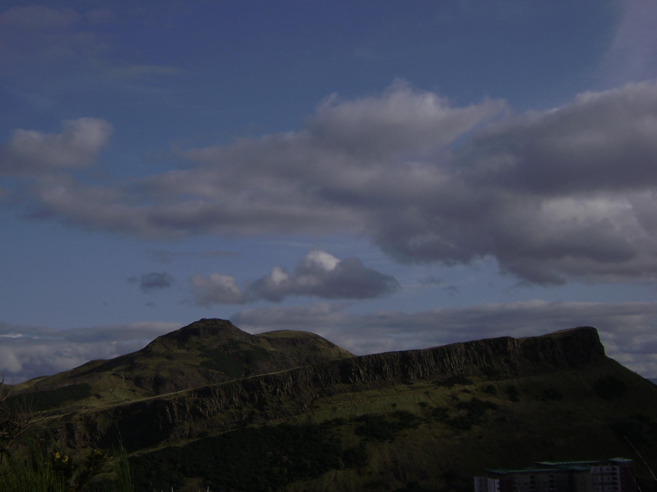
Original Text:
She should have died hereafter. There would have been a time for such a word. Tomorrow, and tomorrow, and tomorrow Creeps in this petty pace from day to day To the last syllable of recorded time. And all our yesterdays have lighted fools The way to dusty death. Out, out, brief candle. Life’s but a walking shadow, a poor player That struts and frets his hour upon the stage, And then is heard no more. It is a tale Told by an idiot, full of sound and fury, Signifying nothing.

Slide 18
Translation:
She would have died later anyway. That news was bound to come someday. Tomorrow, and tomorrow, and tomorrow. The days creep slowly along until the end of time. And every day that’s already happened has taken fools that much closer to their deaths. Out, out, brief candle. Life is nothing more than an illusion. It’s like a poor actor who struts and worries for his hour on the stage and then is never heard from again. Life is a story told by an idiot, full of noise and emotional disturbance but devoid of meaning.

